Slide 1
Sport Governance Capability Framework
WEBINAR SERIES
NSW OFFICE OF SPORT
Presented by: Ian Fullagar, Lex Sportiva
14 April 2021

Slide 2
Sport Governance Capability Framework
The Framework
Context
Rationale
Scope
The review
What’s new?
Business recovery and continuity
2020 Sports Governance Principles
Conclusions
Questions

Slide 3
Sport Governance Capability Framework
Sports Governance Capability Framework and Toolkit
developed in 2018 by Office of Sport (OsS) to assist NSW Sports improve governance practices and skills
ASC 2012 Sports Governance Principles
NSW context: NSW Sports should implement what they can do:
on a needs basis and
within their own particular context
OoS rationale
Continual review, evaluation and improvement of the Sport’s governance within context
Better investment returns for OoS

Slide 4
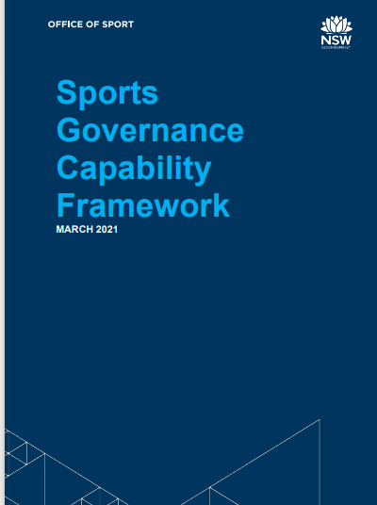
Sport Governance Capability Framework
Outcomes of the Framework
improve the identification of skills that Sports need now and into the future
improve overall quality and effectiveness of governance now and into the future
identify any gaps in governance skills
improve and assist with the recruitment of effective Board members
https://www.sport.nsw.gov.au/clubs/rysso/governance

Slide 5
Sport Governance Capability Framework
The review
Aim
What was undertaken and why?
Alignment
Pros and Cons

Slide 6
Sport Governance Capability Framework
What’s new 1:
Business recovery and continuity plan
Disaster policy
Risk and crisis management resource
https://www.sport.nsw.gov.au/clubs/rysso/riskmanagement/crisis-management-and-sport-business-recovery-resources
https://www.sport.nsw.gov.au/video-library/professional-development-webinars-directors-and-managers-ssos

Slide 7
Sport Governance Capability Framework
What’s new 1 cont’d:
All of the above COVID related but driven by risk and governance!
Ask Sports to consider
Stakeholder relations and external communications
Digital presence, technology capabilities and cybersecurity
Strategic partnerships and other opportunities
Focus on the ‘road to recovery’
Culture

Slide 8
Sport Governance Capability Framework
What’s new 2:
Updated Governance capability framework
Sport Australia Sports Governance Principles
https://www.sport.nsw.gov.au/clubs/rysso/governance

Slide 9
Sport Governance Capability Framework
ASC 2012 Sport Governance Principles
Board Composition and Roles (Constitution and strategy)
Board processes (Evaluation and elections)
Board Induction (Induction requirements)
Board Performance, Behaviour & Culture (Conflicts, risk, compliance, leadership)
Performance Evaluation & Board Development (Skills assessment and audit)

Slide 10
Sport Governance Capability Framework
Sport Australia 2020 Sport Governance Principles
Principle 1: values-driven culture and behaviours
Principle 2: aligned sport through collaborative governance
Principle 3: a clear vision that informs strategy
Principle 4: a diverse board to enable considered decision-making
Principle 5: documents that outline duties, powers, roles and responsibilities
Principle 6: board processes which ensure accountability and transparency
Principle 7: systems which protects the organisation
Principle 8: systems for ensuring integrity
Principle 9: systems of internal review to foster continuous improvement

Slide 11
Sport Governance Capability Framework
Why is Sport different?
Unique structures
History, culture and tradition
Passion
Variety of purposes
The Framework seeks to recognise these differences and allow Sports to apply the Principles to each Sport’s context.

Slide 12
Sport Governance Capability Framework
2020 Principles: “principle” focused cf with practice
focused
The Framework:
continues to capture the principles
is case study based
describes the broad capabilities required of volunteer directors in the Sport sector
seeks to provide Sport directors with a common language for the knowledge and skills that are critical for the stewardship of a Sport
includes knowledge and skills required for particular roles on a board

Slide 13
Sport Governance Capability Framework
What is in the Framework’s tool kit?
Assist Sport directors members implement the Framework
Guidelines, templates, checklists and links
Recommended and optional
Constitution templates - https://www.sport.nsw.gov.au/clubs/rysso/governance/model-constitutions-templates
Board governance charter
Board matrix (larger sports)
Remember: use what is relevant for your Sport! It is not expected that a Sport adopt (or needs to adopt) every lesson and every template in the Framework!

Slide 14
Sport Governance Capability Framework
Conclusions
Sensitivity to the Sport’s environment
Cohesion and identity within the Sport
Build constructive relationships (internal and external)
Conservative financial planning
Govern, grow and evolve
https://www.sport.nsw.gov.au/clubs/rysso/governance
Seek assistance from OoS

Slide 15
Sport Business Continuity and Recovery
Questions

Slide 16
Ian Fullagar Lex Sportiva M: 0428 082 087 lexsportiva@icloud.com
These notes contain comments of a general nature only and is not intended to be relied upon, not as a substitute for specific professional advice. No responsibility can be accepted by Lex Sportiva or the authors for loss occasioned to any person doing anything as a result of any material in this publication.

