Slide 1
The Duke of Edinburgh’s International Award
Award Centre Name
Notes:
If delivering to Year 9, consider having Year 9 coordinator and an Award Captain available to speak and/or answer question.
Can play this video on a loop as guests arrive (if delivering in person): https://www.youtuberepeater.com/watch?v=NlnG-eQMmCQ#gsc.tab=0
Recommend checking the video on slide 8 works before presenting.

Slide 2
The Duke of Ed is a global youth development program,
empowering young Australians aged 14-24
to explore their full potential
Notes:
If you have previous Duke of Ed Participants invite them to give a brief talk on why they signed up and what they got out of it.

Slide 3
Why do the Award?
Experience a sense of adventure and learn outside the classroom
Adapt the Award to suit your interests, passions and ambitions
Gain employability skills and make your resume stand out
Be recognised for your extracurricular and sporting activities
Challenge yourself
Meet new people and have fun
Global Award recognised in more than 130 countries
Notes:
Develop teamwork in a fun environment
Learn and develop life skills
Bonus Adjustment Factor points currently available at Macquarie University (Silver and Gold) and UNSW Sydney (Gold).
Highlight the benefits you think would be of most interest to your young people.
Highlight the alignment to the school curriculum

Slide 4
Award Framework
Notes:
All Participants learn a new skill, improve their physical wellbeing, volunteer in the community and experience a team adventure in a new environment.
Can complete all three levels or start directly at a later level.
Each Participant’s Award is different, the sections are customisable to suit their individual interests, passions and ambitions.
Section examples later in the presentation.
The “regular” sections need definition/ explanation – especially time requirements ie. “regular” activity - means at least 1 hr per week, 2 hrs per 2 week period, or 4 hrs per 4 weeks.

Slide 5
Voluntary Service
Connect with the community and give service to others.
Sport umpiring or coaching
Field of play set-up
Community groups
Award Assistant
Community group canteen/BBQ
Animal care (RSPCA/WIRES)
Environmental care
Fundraising
Club administration
Emergency services (SES/RFS)
Environmental regeneration and conservation
Youth leadership
Tutoring
Time must be spent on a genuine cause, not for a business, family member, friend of neighbour
Notes:
This is a good opportunity to interact with audience.
These are examples and not an exhaustive list and provides opportunity for suggestions from the audience
Challenge them to think of an issue that is important to them and encourage them to volunteer their time there.

Slide 6
Physical Recreation
Improve your health, fitness, team skills and confidence.
Training and playing sports
Gym training
Fitness training
Yoga
Dancing
Running/jogging
Cycling
Bush walking/hiking
Rowing/kayaking
Martial arts
Need help finding a sport? Contact the Duke 4Sport partners
Notes:
Good opportunity to interact with audience

Slide 7
Skills
Develop your personal interests and non-physical skills
Languages including Auslan
Photography
Sport game scoring, coaching or officiating
Coding
Digital media production
Music
Sewing and cooking
Meditation/ mindfulness
Notes:
Good opportunity to interact with audience
Can complete qualifications i.e. umpiring course.
Mention that skills should in general be non-physical I.e. Dance is physical recreation not a skill.

Slide 8
Notes:
A sense of adventure and discovery within a group journey
If you know where your Participants will be going for your AJs mention this in the presentation.

Slide 9
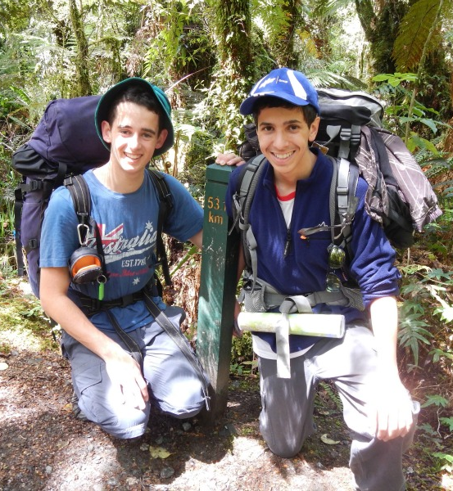
The AJ Process
Ensures Participants are competent in the necessary knowledge and skills to safely undertake their Practice Journey.
Preparation and Training
Practice Journey(s)
Prepares the team for their independent Qualifying Journey.
Qualifying Journey
Independent team Journey.
Qualifying AJ Report
Reflection on the AJ
Notes:
Explain there is prep and training, a practice journey and a qualifying journey.
Can update the picture to include your previous Participants on their AJ.

Slide 10
Assessors
Suitably skilled, qualified and experienced adults. Examples:
Teacher
Coach
Instructor
Help you set your SMART goals.
Give final sign-off on the activity.
Must meet Working with Children Check requirements.
Notes:
Cannot be a family member.
Does not need to be with the Participant for every hour that they log.
Mention Assessor Commencement Guide.

Slide 11
How to get Started
Speak to your Award Leader.
Visit www.onlinerecordbook.org to register your interest for the Award:
Get your parent/guardian's approval
Pay the registration fee
Record all future Award information in the ORB (web and app versions)
Notes:
Mention any school specific registration processes.
Mention parent/guardian approval is required.
Mention all Assessors are pre-approved and require mandatory Child Safe checks

Slide 12
Award Leader Contact Details
Name
Position
Email
Contact Number

