Slide 1
Sport Priority Needs Program
Information session
Karen Jones
Chief Executive, Office of Sport
2 September 2022

Slide 2
Acknowledgement of Country
I would like to acknowledge the Traditional Custodians of the Land on which this meeting takes place, and to show my respect to Aboriginal Elders past, present and emerging.

Slide 3
Welcome
Office of Sport

Slide 4
Contents
About the Sport Priority Needs Program | 5 |  | Application Process | 17
Important Dates | 6 |  | Late Applications | 18
Program Purpose | 7 |  | Assessment Process | 19
Program Objective | 8 |  | Eligibility Check | 20
Funding Availability | 9 |  | Completeness Check | 21
Council Expenditure | 11 |  | Supporting Documents | 22
Eligible Applicants | 12 |  | Key Points | 23
Community Consultation | 13 |  | Support for Applicants | 24
Eligible Grants Cost | 15 |  | Questions | 25
Eligible Projects | 16 |  | Thank you | 28

Slide 5
About the Sport Priority Needs Program
The Sport Infrastructure Recovery Fund announced in May 2022 is part of the broader $207 million 2022 Community Local Infrastructure Recovery Package.
The $55 million Sport Infrastructure Recovery Fund will be delivered in two stages:
$12 million Sport Priority Needs Program
$43 million Essential Community Sport Assets Program
The Sport Priority Needs Program will provide the opportunity for communities to respond to the February-March 2022 flood events and assess, repair, reconstruct and build flood resilience into sport facilities.
This first stage of funding is a key recovery measure to help enable eight highly impacted communities to recover as fast as possible by returning to sport activities including training and competition.

Slide 6
Important Dates
Stages | Dates
Applications open | Wednesday 24 August 2022
Applications close | 2pm, Friday 23 September 2022
Outcomes advised | October 2022 onwards
Funding agreements executed for successful projects | Within 3 months of notification of outcomes
Commencement of projects | Within 6 months of notification of outcomes
Projects to be completed By December 2024

Slide 7
Program Purpose​
The purpose of the Sport Priority Needs Program is to prioritise funding to support LGAs whose sport and recreation facilities are considered most impacted. The Program supports applicants to:
Undertake detailed damage and technical assessments, feasibility studies, planning, detailed designs and options for investments to mitigate risks for impacted essential community sport facilities.
Repair, reconstruct and support future resilience in sport facilities to ensure safe and accessible facilities are immediately available for return to training and competition.
Promote and support environmental sustainability and climate resiliency measures in design, construction and operation.

Slide 8
Program Objectives​
Be informed and co-designed with and by communities to reflect the needs of impacted communities and to reduce the burden on applicants
Incorporate a range of support measures to allow flexibility for applicants and that reflects community-specific capability and capacity
Be based on evidence of impact to essential community assets to provide targeted support
Be designed and delivered with a focus on supporting asset repair, rebuild and/or projects that include a focus on supporting future resilience.

Slide 9
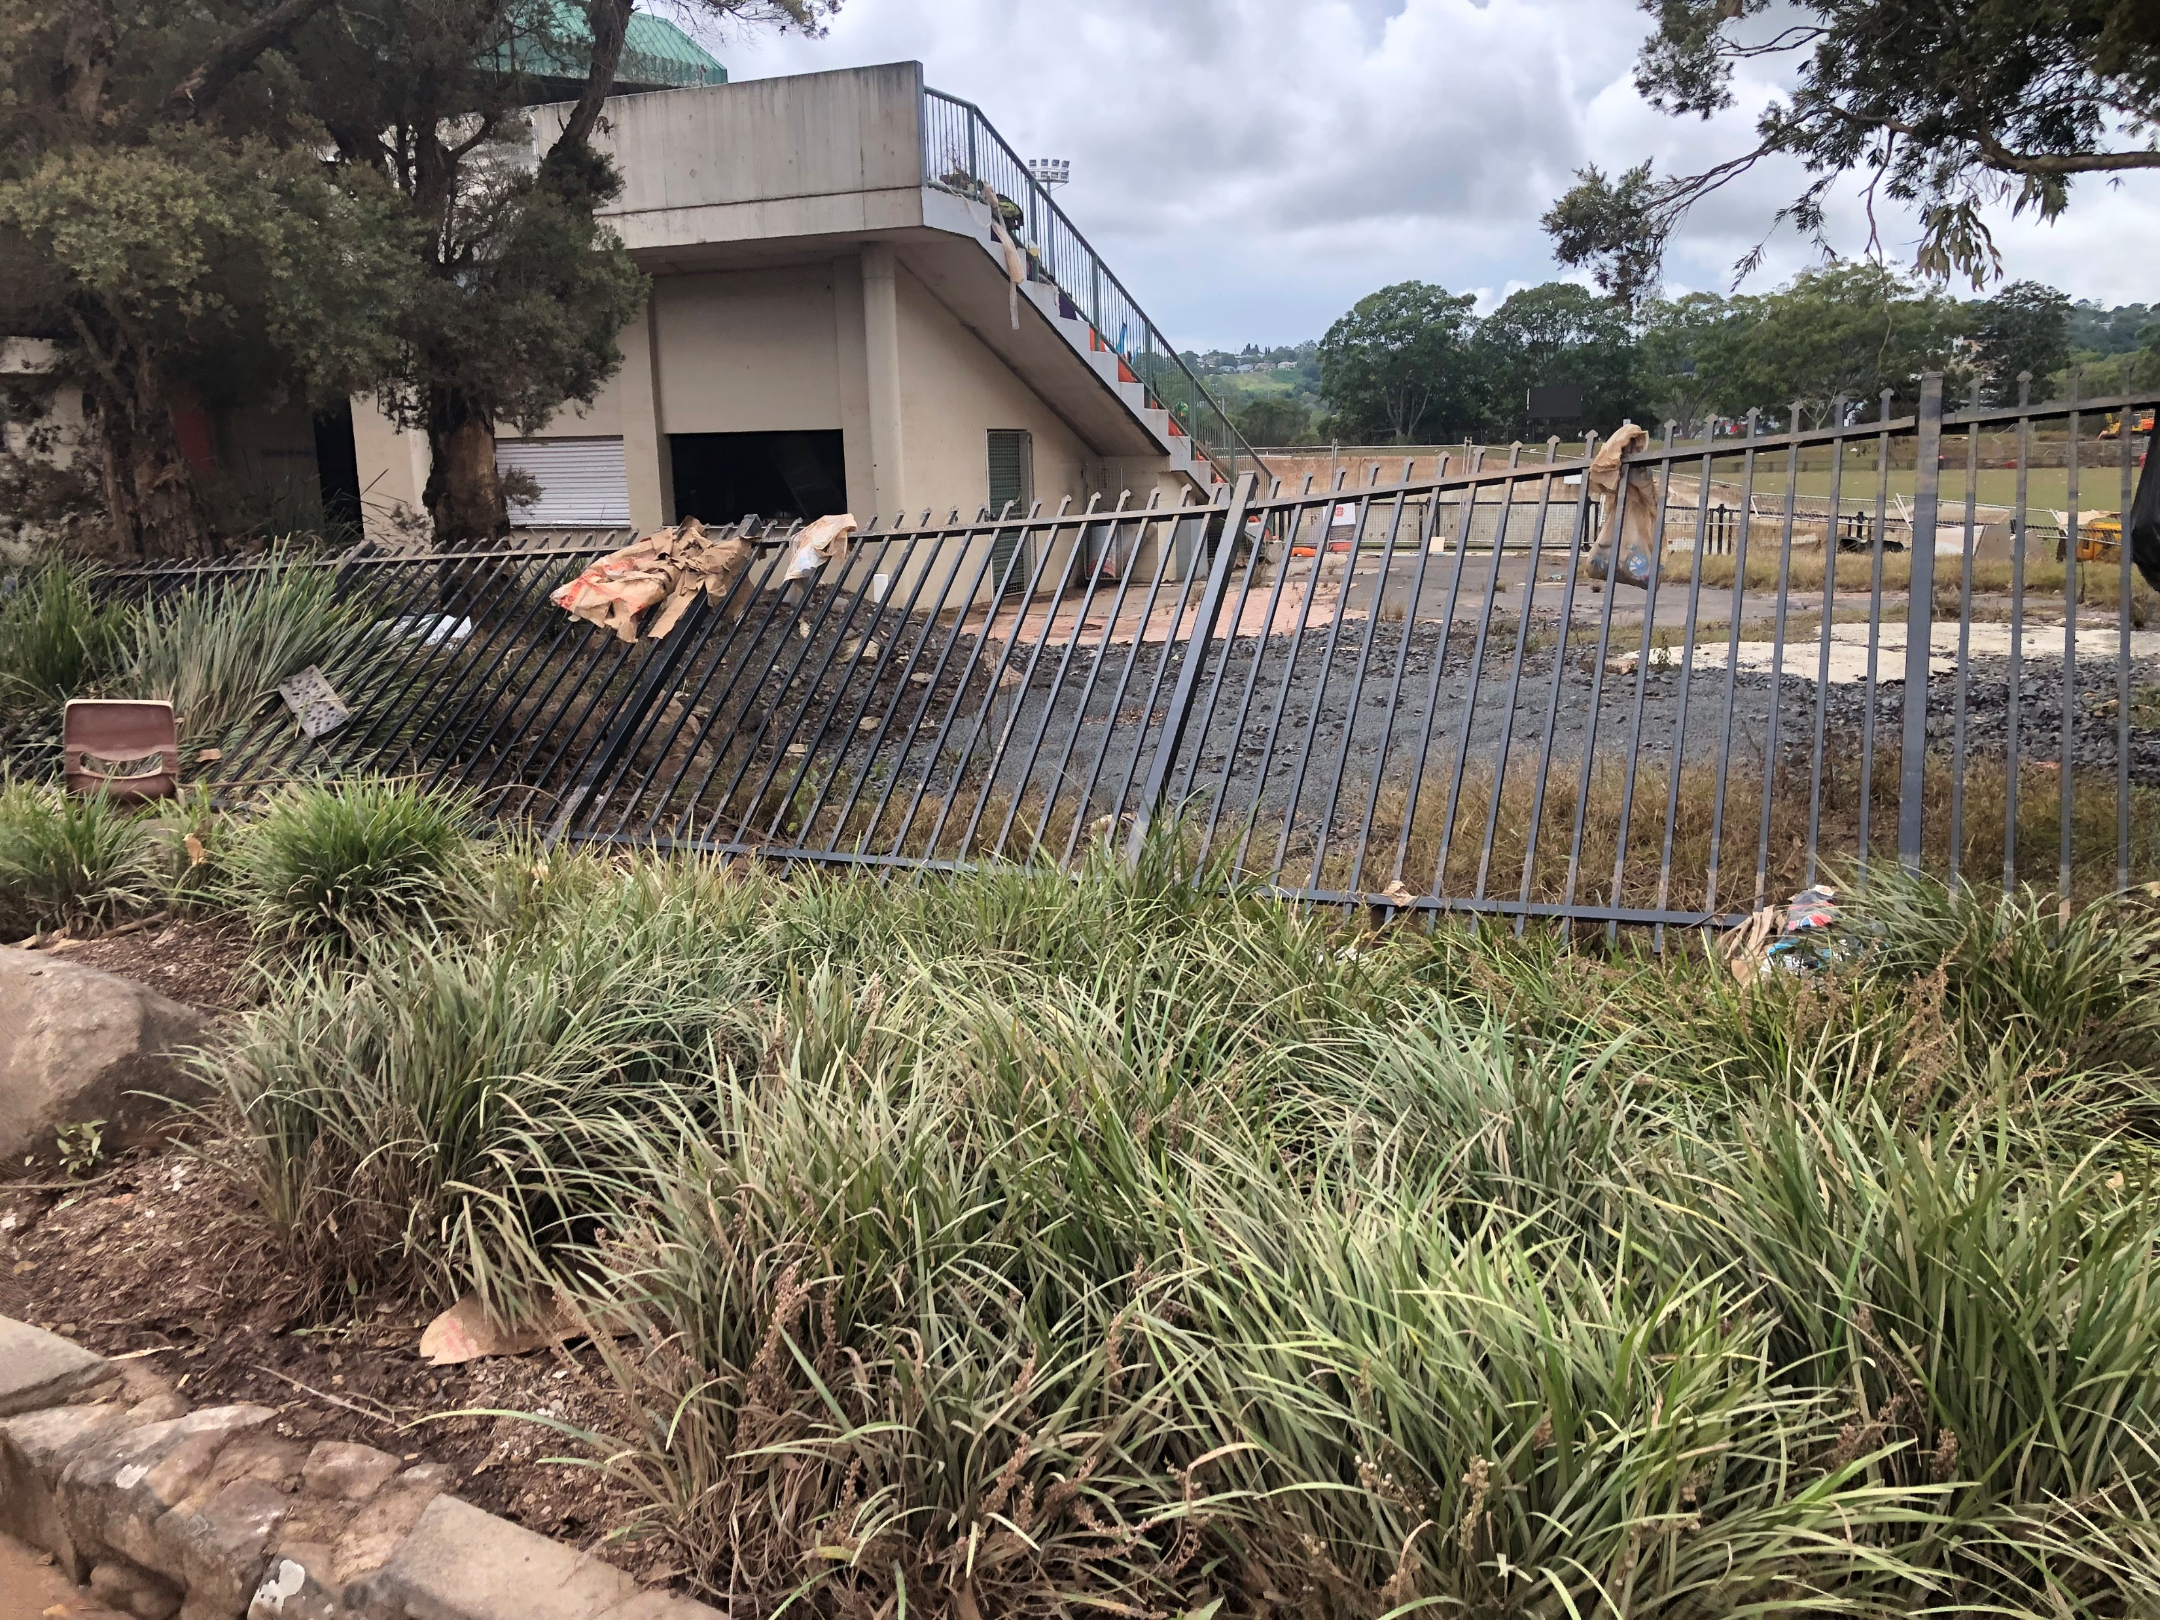
Funding Availability
The NSW Government is allocating $12 million to the Sports Priority Needs Program.
Based on a notional funding allocation of up to $1.5 million for each of the eight eligible councils.
The grant amount requested for a project must be a minimum of $15,000 and cannot exceed $500,000.
A financial co-contribution is not a requirement of the Program.
In council’s application there is no cap on the number of projects that can be submitted. Council is asked to rank projects in their order of priority.
If the notional allocation per LGA is not fully exhausted, then funding from these LGAs may be redistributed to any of the other eligible LGAs for projects that align to the Program objectives and purpose.
Redistribution is undertaken at the recommendation of the Office of Sport and with approval by the Minister for Sport.

Slide 10
Funding Approval and Process
All successful applicants must enter into a funding agreement with the Office of Sport. Grant payments will not be made until an executed funding agreement is in place. The Office of Sport will not be responsible for any project expenditure until this time.
Funding approval may also have specific conditions that have been determined throughout the assessment process.
There is no limit on the number of projects a council can include in its application as long as the projects meet the criteria of the Program. Eligible councils will submit their application including information and documentation for each prioritised project. Council must advise of their project priority ranking through the application form.
If an eligible council is submitting 11 or more projects, the council will need to lodge an additional submission through the same SmartyGrants link. Both SmartyGrants submissions will then be assessed as one application.
The Office of Sport reserves the right to recommend grant amounts that may differ from the amount requested for a project in the application. Any such details will be specified in a written offer as well as in the funding agreement. Applications should identify the risk of each project not proceeding should the full grant amount requested not be approved.
Where appropriate, projects may be referred to other funding programs for consideration.

Slide 11
Council Expenditure
Each council can spend up to a maximum of 5% ($75,000) of their allocated funds (up to the notional allocation of $1.5 million) for work related to the preparation of their grant bids, scoping of projects and preparation of applications.
Costs can include engagement of consultants and contractors to undertake community consultation and prepare grant documentation.
Council will need to budget for this expenditure and recognise the expenditure will be deducted from their allocated funds.
As part of the application process council can identify their intention to claim expenditure incurred. Council will need to demonstrate that they have incurred the expenses over and above their normal operations, and how the funding has been used.
Expenditure up to $75,000 is for total expenses incurred in submitting all projects in a council’s application. Expenditure may occur prior to application lodgement and can be claimed as expenditure as part of the first milestone payment.

Slide 12
Eligible Applicants​
The following councils are eligible for the Program as they are declared natural disaster areas as per Australian Government reference number (AGRN) 1012 and have been assessed as highly impacted:
Ballina Shire Council
Byron Shire Council
Clarence Valley Council
Hawkesbury City Council
Kyogle Council
Lismore City Council
Richmond Valley Council
Tweed Shire Council.
You must be one of the eight eligible councils to apply. Sporting entities in the eligible LGAs should bring their projects to the attention of eligible councils.
Further information on other measures under the Sport Infrastructure Recovery Fund will be provided in September 2022.

Slide 13
Community Consultation​
Councils should bring this funding opportunity to the attention of local sporting organisations and sport facility asset owners/managers and work with them to identify project partnership opportunities and priority projects in their LGA
Local councils should consult with:
Relevant NSW Office of Sport recognised NSW State Sporting Organisations (including National Sporting Organisations where the state body is part of a unitary governance model)
Incorporated, community-based, not-for-profit sporting organisations (clubs and associations whose primary purpose is to organise sporting activities/deliver sport programs)
Organisations providing sport and recreation programs that benefit the community, such as PCYCs, Y NSW and YWCA
Private enterprises who provide public access to sport participation activities.
Partnerships between council and sporting groups are encouraged however council must apply on behalf of the sporting club or association. The council will be the grant recipient and will enter into a funding agreement with the Office of Sport.

Slide 14
Social Tiles for Community Consultation
Social tiles for community consultation are available for use.
Please contact infrastructuregrants@sport.nsw.gov.au

Slide 15
Eligible Grant Costs ​
Work related to the preparation of grant bids, scoping of projects and preparation of applications not exceeding 5 per cent of their allocated funds
The delivery of eligible projects, including administration costs and project management costs not exceeding 20 per cent of the requested funding
Detailed Damage Assessments, Feasibility Studies, detailed designs and technical reports, and preparation of business cases
Capital works costs for the repair, rebuild or support project resilience of sport infrastructure works directly related to storm and flood damage and works that have not yet commenced
Works on directly damaged community sport infrastructure not yet commenced to support future disaster resilience
Works directly related to storm and flood damage in February-March 2022 that have not been covered through other NSW or Australian Government funding and/or insurance claims
Salary/wages and entitlements for employees/contractors and/or consultants specifically engaged for the project(s)
Retrospective costs (with the exception of costs related to grant application preparation) may be eligible in exceptional circumstances on the basis that the works were required to be undertaken in order to ensure safety and/or accessibility to the public or property. This will be determined by the Office of Sport.

Slide 16
Eligible Projects ​
The Program Guidelines give examples of both eligible and ineligible project types and project components and costs.
Please take the time to review this section of the Program Guidelines carefully. Ineligible project scope and components will not be funded.

Slide 17
Application Process
Step 1: Check your eligibility | Step 2: Prepare your application | Step 3: Submit your application
Before applying, you need to read the guidelines and related materials to make sure you understand all relevant requirements, including how to identify whether projects you have identified are eligible. You can find the relevant information including guidelines on the Office of Sport’s website. | Applying for the Sport Priority Needs Program is a simple process using the SmartyGrants website sport.smartygrants.com.au/SPNP-2022 . Councils can familiarise themselves with the online application form and can download a copy of the application form prior to commencing preparing the application. Councils can work with stakeholders in the preparation of project information. Complete the application by filling in each of the sections for each project submission. | A letter of approval from Council’s General Manager approving the submission of the application and prioritisation of projects must be uploaded to SmartyGrants. Council’s application must be submitted through the SmartyGrants website before the closing date and time. Successful submissions will receive a SmartyGrants system generated acknowledgement email containing a PDF copy of the application which will confirm the time the application was submitted.
Application Timeline

Slide 18
Late Applications
Submissions
​Late applications can only be made where an applicant has substantially completed an application in SmartyGrants prior to the closing date/time.
If for some unforeseen reason you are not able to lodge your application on time, you must contact the Grants Infrastructure Team at the Office of Sport at infrastructuregrants@sport.nsw.gov.au or phone 13 13 02 at the earliest possible time and within one hour of the closing date/time.
A late application will only be considered where its acceptance would not compromise the integrity of the process. The final determination on whether a late application will be accepted will be made by the Office of Sport supported by a probity advisor.
Documentation
If any document is not available prior to the closing date/time and you would like to submit this for consideration you must contact infrastructuregrants@sport.nsw.gov.au within one hour of the closing date/time.
Late supporting documentation will only be accepted for applications already submitted in SmartyGrants and where its acceptance would not compromise the integrity of the process. The final determination on whether late supporting documentation will be accepted will be made by the Office of Sport supported by a probity advisor.

Slide 19
Assessment Process
An independent probity advisor will oversee the grant process.
The Office of Sport will complete an eligibility and completeness check on each project within council’s application.
Throughout the assessment process the Office of Sport may request additional information from the applicant.
Project assessment may include seeking expert advice from relevant NSW or Australian Government agencies or other subject matter experts.
The Minister for Sport will consider the recommendations of the Office of Sport and make decisions relating to the approval of funding.
Eligibility Check
Completeness check

Slide 20
Eligibility Check
The Office of Sport conducts an eligibility check of all projects within a Council’s application
Applicant is an eligible applicant
Applicant has provided an ABN/ACN and/or Incorporation number
Projects are located in an eligible LGA (eligible LGAs include Ballina, Byron, Clarence Valley, Hawkesbury, Kyogle, Lismore, Richmond Valley and Tweed)
Projects are directly related and address direct damage to community sporting infrastructure damaged as a result of the floods in February-March 2022 that led to the NSW Natural Disaster Declaration - Australian Government Reference Number (AGRN) 1012
Projects have a project grant request which is a minimum of $15,000 and does not exceed $500,000
Projects are not covered by insurance or any other NSW or Australian Government programs or flood recovery initiatives
The Office of Sport will undertake an eligibility check on all grant applications and will make the final determination on eligibility.

Slide 21
Completeness Check​
It is important to review the completeness check criteria in the Guidelines and preview the SmartyGrants application form, to ensure you are submitting a completed application with applicable supporting documentation.
The eligibility and completeness check criteria are detailed in the Guidelines on the web page. The Office of Sport will undertake a completeness check of all eligible projects against the completeness check criteria.
The Office of Sport recommendations for funding to the Minister for Sport will include each council’s prioritised project list including confirmation of project eligibility, project completeness and any recommended special conditions to be included in the funding agreement.
The Minister may consider broader factors in determining project approvals including the level of community support, variety of project size, scale, type and focus, project grant request and funding available, suitability of projects for other government funding opportunities and alignment with existing NSW and Australian Government policies and strategies.
The Fund criteria are:
Strategic alignment and community need
Project scope, design and resilience building
Project affordability
Project deliverability and applicant capability

Slide 22
Supporting Documents
Documents available on the Sport Priority Needs Program web page to assist your application include:
Program Guidelines
Frequently Asked Questions (FAQs)
Landowner Consent Form Template
Budget Template
Funding Agreement Template

Slide 23
Key points to take away from this session:
SmartyGrants
Please visit https://sport.smartygrants.com.au/SPNP-2022 and allow yourself time to familiarise yourself with the portal. As applications are now open, you can download a preview application form from the SmartyGrants website prior to commencing your application.
Please remember that to be considered eligible, the project must be submitted through the SmartyGrants website.
Frequently Asked Questions
Frequently asked questions are available on the Program website to support you in preparing your application.

Slide 24
Call: 13 13 02 Email: infrastructuregrants@sport.nsw.gov.au Website: https://www.sport.nsw.gov.au/grants/sport-infrastructure-recovery-fund/sport-priority-needs-program
Support for Applicants

Slide 25
Questions
Q: Is a financial co-contribution required for the Sport Priority Needs Program?
A: No
Q: What if projects are less than the minimum grant request?
A: Grant request must be a minimum of $15,000. The NSW Government offers other funding and assistance packages for smaller grant requests. This includes natural disaster financial assistance to help sporting and recreation clubs directly affected by a declared natural disaster including flood, fire or storm damage. This low interest rate loan up to a maximum of $10,000 can help meet the costs of restoring essential club facilities, equipment or other assets that have been damaged or destroyed by a natural disaster. Further information can be found at: Disaster relief loans - Sporting and recreation clubs (nsw.gov.au).
Further information on NSW Government grants and funding including the Local Sport Grant Program is available at: Grants and funding | NSW Government.
Q: When will the first milestone be paid?
A: The first milestone payment will be made on execution of the Funding Agreement. This is expected to be October/early November 2022. The Office of Sport will support successful applicants to finalise project milestones, establish and execute a funding agreement.

Slide 26
Questions
Q: When will successful projects need to be delivered by?
A: It is anticipated the Program and expenditure will conclude by December 2024.
Q: What works constitute project commencement?
A: Project commencement varies depending on the project. It may include the awarding of contracts, engagement of consultants, undertaking detailed damage assessments, feasibility studies, detailed designs and technical reports, and preparation of business cases. It may include the physical construction or preparation of materials offsite. For large and complex projects, it may be approval from council to proceed with the project through a council resolution or executive minute.
Q: What works constitute project construction commencement?
A: Physical works that are part of the project construction. These works include, but are not limited to, early works construction packages, site clearing and demolition, earthworks or building works and the physical construction or preparation of materials offsite.

Slide 27
Questions
Q: Can applicants include projects that incorporate Infrastructure Betterment?
A: Yes. The purpose of the program is to support future resilience in sport facilities and to promote and support environmental sustainability and climate resiliency measures in design, construction and operation.
Q: What is infrastructure betterment?
A: Infrastructure Betterment is repairing or building-back an asset that can better withstand future natural disasters while delivering benefits associated with improved resilience and generating productivity, economic and social outcomes. Betterment is made up of the following core values:
Resilience – Reduce the risk of impact to an asset over its lifecycle to better withstand natural disasters, and improve the ability to respond, recover and adapt after asset disruption.
Productivity – Maintain or improve the level of service and sustainable function that an asset provides.
Economic – Achieve net benefits across the asset lifecycle based on the betterment value proposition and provide a return on investment.
Social – Maintain or improve a community’s ability to function during and after a disruption to an asset.

Slide 28
Questions
Q: How do successful applicants acknowledge the funding when projects are underway?
A: All successful applicants will receive detailed information about how they must acknowledge NSW Government funding for infrastructure projects. Successful applicants will receive full guidelines, logo and signage template files.
A condition of funding will include the publication of successful projects for each LGA to be published on council’s website and that publicly available project delivery updates are provided to the community.
Q: What funding is available under the Essential Community Sport Asset Program?
A: Up to $43 million has been allocated to the Essential Community Sport Assets Program from the Sport Infrastructure Recovery Fund.
Q: When will applications open for the Essential Community Sport Asset Program?
A: Further information on the Essential Community Sport Assets Program will be available from September 2022.

Slide 29
Questions
Q: What project cost estimates should a council provide?
A: Councils should provide evidence in support of the cost estimates in their application. This may be supplier/builder quotes or estimates by a council engineer. Council’s procurement of goods and services for projects funded under the program must comply with OLG Tendering Guidelines and the council’s procurement policies.
Q: What community consultation do we need to undertake?
A: The Guidelines do not specify what is sufficient community consultation, only that it is recommended a council undertake it. A council should be satisfied that their application has taken into account the priority sport infrastructure needs of their community and any evidence of community consultation a Council can provide will assist in the review an application.

Slide 30
Thank You

