Slide 1
NSW Football Legacy Fund Round 2 2023/24 PARTICIPATION STREAM
Information session – JUNE 2023
Nick Titcume Senior Project Officer - Major Sport Events Office of Sport
8 June 2023

Slide 2
Acknowledgement of Country
The Office of Sport acknowledges the Aboriginal people, the Traditional Custodians of this land, and pays respect to our Aboriginal Elders – past, present and emerging.

Slide 3
CONTENTS
Program overview
Program objectives
Eligible applicants
Projects costs & ineligible project costs
Key considerations for your application
Required documents
Application process
Assessment criteria and process
Applications Timeline
Contact Information

Slide 4
Program Objectives
The key objectives of the Participation Stream of the Fund are to:
Increase participation in football
Increase participation of women and girls and/or new markets
Improve female leadership opportunities for players, officials and coaches
These objectives align with Football Australia’s (FA) Legacy ’23 strategy, contributing to FA’s aim of 50% female participation by 2027.

Slide 5
Program Overview
Applications open: Thursday,
8 June 2023
Applications close: 1pm Friday,
7 July
2023
Total funds available for round 2 of the grant program is: $560,000 (Ex GST)
Grants are available from $2,500 to $15,000.
Notes:
This is the second round for the grant program. For this round there will be up to $560,000 in funding available under the participation stream.
The minimum grant amount is $2,500 and the maximum is $15,000.
For all projects, applicants must contribute 25% to the total cost of the project. So as an example if your total project cost is $10,000, you can apply for $7,500 and need to contribute a matched amount of $2,500.
Applications are now open and will close at 1pm on the date listed here.

Slide 6
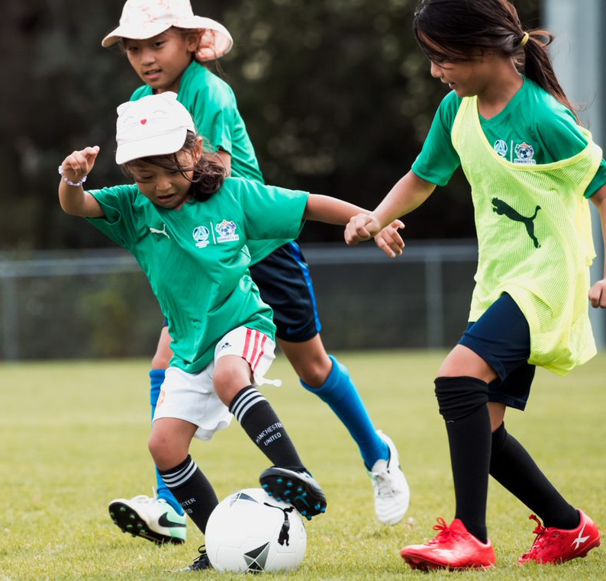
Eligible Applicants
To be eligible for this grant program, applicants must be one of the following:
Incorporated, not for profit clubs, associations, zones or other deliverers in NSW that are affiliated, recognised and/or sanctioned by Football NSW and/or Northern NSW Football, or
Incorporated, not for profit organisations that provide football programs or services. (These organisations require a letter of support from Football NSW or Northern NSW Football);

Slide 7
Eligible Projects
The Fund can be used to support increased football participation and leadership programs. Priority will be given to projects that demonstrate how the project will contribute to greater gender equity in football.
Examples of eligible projects include:
New or enhanced programs targeting women and girls’ participation (e.g. girls only holiday clinics, girls leagues)
New or enhanced programs targeting participation of under-represented groups and/or new markets
Programs or projects aimed at ensuring clubs are welcoming and safe for all participants
Purchase of equipment that supports increased participation
Programs or projects which support accredited coaching, officiating or inclusivity education, leadership development or training

Slide 8
Ineligible Project Costs
Some examples of ineligible projects or project components include:
Projects that are not primarily for football activities
Food, drink, catering or hospitality, prize money, trophies/awards or attendance incentives
Wages for administrative and/or executive staff or office equipment
Projects that have already received NSW Government Funding
Further detail regarding eligibility and ineligibility can be found in the Fund Guidelines Round 2 2023/2024, and by contacting the Office of Sport at grantsunit@sport.nsw.gov.au

Slide 9
Key Considerations for your Application
For all projects, applicants must contribute 25% to the total cost of the project. Co-contribution can be financial and/or in kind (such as field hire costs, volunteer coaching hours)
Third party organisations are also encouraged to contribute and these contributions will be counted as part of the applicant’s contribution.
Organisations may only receive State Government funding once for the same project
Projects must be completed within 1 year from signing the Funding Agreement.​
Notes:
Remember, for all participation projects, applicants must contribute 25% to the total cost of the project. Your contribution can be achieved through a financial contribution, in-kind or a combination of both. The budget tab in the grants system will provide guidance and show the totals/overall percentage of contribution once you complete it.
Examples of in-kind contributions might be volunteer coaching or a ground hire component that has been paid for. When calculating volunteer hours, $50 per hour is a reasonable amount.
Third party organisations are also encouraged to contribute and these will be counted as part of the applicant’s contribution. This might be from council, a local business, sponsor/supplier etc. If you are charging participants a fee (with the grant subsiding the program) that is OK also.
A supplier discount is not considered as a contribution.
Organisations may only receive State Government funding once for the same project or component of a project
Projects must be completed within 1 year of signing the funding agreement

Slide 10
Application Process
Step 1: Check your eligibility and know the requirements
Step 2: Prepare your application
Step 3: Submit your application
Read the Fund Guidelines to check if your organisation is eligible and review all relevant requirements. Fund Guidelines can be found here.
You can find the relevant information on the Office of Sport’s website: NSW Football Legacy Fund | NSW Government
If you are not eligible, you can partner with an eligible organisation, although they will need to be the applicant organisation and submit the application.
Gather your evidence first including letters of support, funding commitments/bank statements, quotes, program documentation, participation data etc
You will need to register in the SmartyGrants system. Use organisation generic emails where possible
Seek support for the project by forming partnerships with key stakeholders
Use the ‘Apply Now” link on the NSW Football Legacy Fund | NSW Government page.
All mandatory fields of the application must be completed, and mandatory supporting documents must be uploaded and submitted
Submit the application by the closing time/date of 1pm, Friday 7 July 2023

Slide 11
Assessment Criteria and Process
All applications should address the program’s criteria.
Please take time to think about your application so you can demonstrate:
Strategic Justification, project scope and need (50%) - Alignment to the Fund priorities
Value for Money (25%) – The project cost is effective, with a detailed budget that delivers public value
Project Deliverability and Applicant Capability (25%) – The project is well planned and the applicant has the capability to deliver
The eligibility and assessment criteria are detailed in the Fund Guidelines, which is available on the Office of Sport web page.

Slide 12
Application Timeline
Stages | Dates
Fund Opens for applications | Thursday 8 June 2023
Fund Closes for application | 1pm, Friday 7 July 2023
Approval of projects | From October 2023
Announcement of approved projects | From November 2023
Funding Agreements entered into by successful applicants | From November 2023
Projects Commence | From November 2023
Notes:
Now on to the all important timeline.
Applications are now open, make sure you submit by the closing date.
We are hoping the assessment process will be completed by October 2023 with final sign off in November. Successful and Unsuccessful applicants will then be notified with successful applicants provided funding agreements for execution by the end of November. This means that projects must be completed by November 2024.
On project completion a final project report and acquittal will be required.

Slide 13
Contact Information
Potential applicants are encouraged to talk to your local Football NSW or Northern NSW Football development officer.
For technical assistance with your application, please contact the Office of Sport:
Phone: 13 13 02 Email: grantsunit@sport.nsw.gov.au
Further information can be found on the Office of Sport website including the Program Guidelines, FAQs and in the Program SmartyGrants online system.

Slide 14
Thank You
Enquiries
Email: grantsunit@sport.nsw.gov.au Phone: 13 13 02

