Slide 1
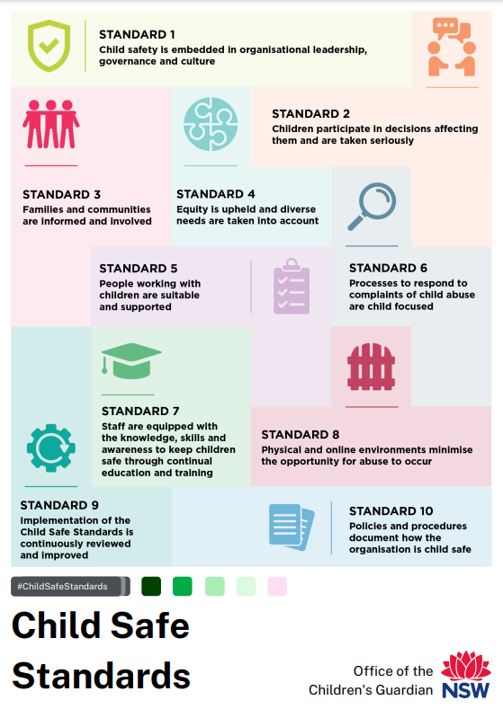
Please insert your logo here
Implementing the Child Safe Standards (at…sport/organisation name)
Notes:
Some sample graphics included here (taken from the Child Safe Standards Media Kit: https://ocg.nsw.gov.au/child-safe-scheme/child-safe-standards-media-kit

Slide 2
The content covered may be distressing for some participants
If you require support, please contact …
Optional - footer information (Child Safe Sport implementation – membership presentation)
Notes:
DELETE this slide if you think it’s unnecessary for your audience (or right click on the slide and choose “hide” for your presentation)

Slide 3
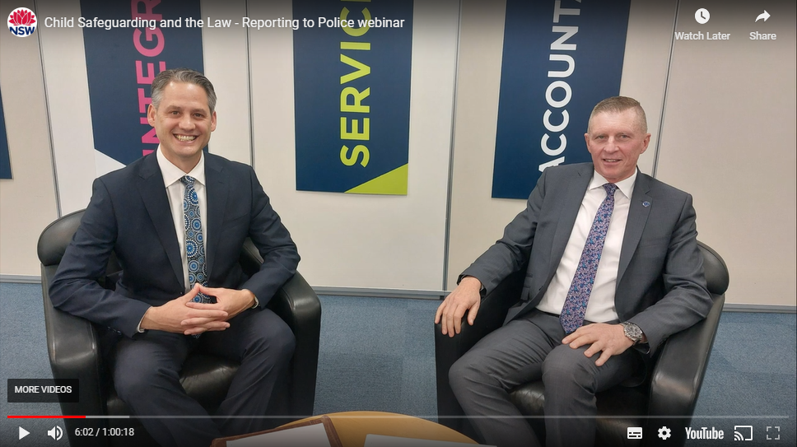
Some concerning statistics… - Child Abuse Squad - NSW Police Force
k
Squad takes on up to 6500 new cases annually*
Squad facilitates 600–700 arrests per year (a high figure)*
Upwards of 12 persons being arrested each week*
95% of offenders are well known to the victims*
Figures above are for assaults only (ie not including internet-related crimes etc..)*
There were 8000 reports of child sexual abuse material made in the first three months of 2023 alone
Sources:
*Figures from Detective Chief Inspector Peter Yeomans, Child Abuse Squad – NSW Police Force “Reporting to Police” webinar – 28 June 2023 (“Child Safeguarding and the Law” webinar series)
Notes:
DELETE this slide if you think it’s unnecessary for your audience (or right click on the slide and choose “hide” for your presentation) … OR…edit some of the points to shorten the text
NOTE – bulleted text on this slide appears progressively upon clicking

Slide 4
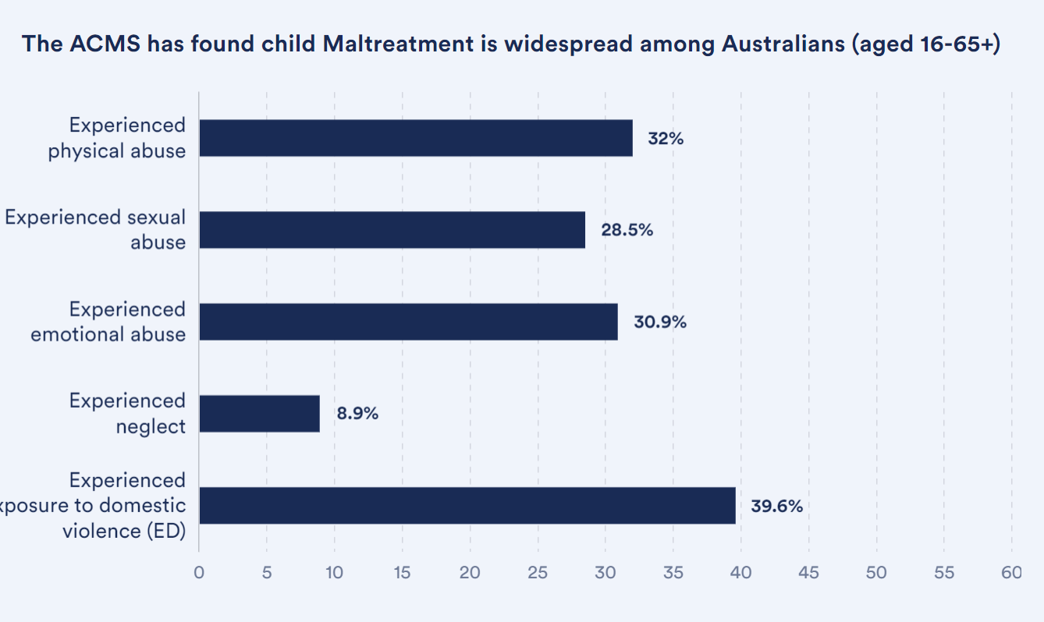
National prevalence of child maltreatment in Australia
k - Australian Child Maltreatment study (2023)
Australian Child Maltreatment Study - findings
Notes:
DELETE this slide if you think it’s unnecessary for your audience (or right click on the slide and choose “hide” for your presentation)
BACKGROUND NOTES – Recent study/figures highlight that child abuse and neglect (maltreatment) is still prevalent in Australian society.
The age bracket (16 – 65+) points to the experience of maltreatment having an impact long after childhood

Slide 5
The 10 Child Safe Standards
The Child Safe Standards provide a framework for creating child safe organisations
They emphasise the importance of adopting multiple strategies to address child safety
When organisations apply the Child Safe Standards, they build a culture where abuse and neglect of children is prevented, responded to and reported
Who the Child Safe Standards apply to
Notes:
NOTE – bulleted text on this slide appears progressively upon clicking
A useful way to think of the 10 Standards is as an interconnected puzzle The Standards don’t stand in isolation, they reinforce each other. Like a brick wall - if one Standard is missing - it undermines the other Standards. How each sport and/ or active recreation organisation best implement the Standards might look a little different. The Standards are outcomes focused, meaning the OCG doesn’t dictate how each club or organisation must meet the Standards, as long as they are endeavouring to do so.

Slide 6
Child Protection and Child Safety in sport and active recreation…
www.youtube.com/watch?v=NN-S1P7_62M (1m:45s)
Notes:
BACKGROUND NOTES – If you don’t think this is the best video for your audience then perhaps choose a more appropriate one from the resources listed.

Slide 7
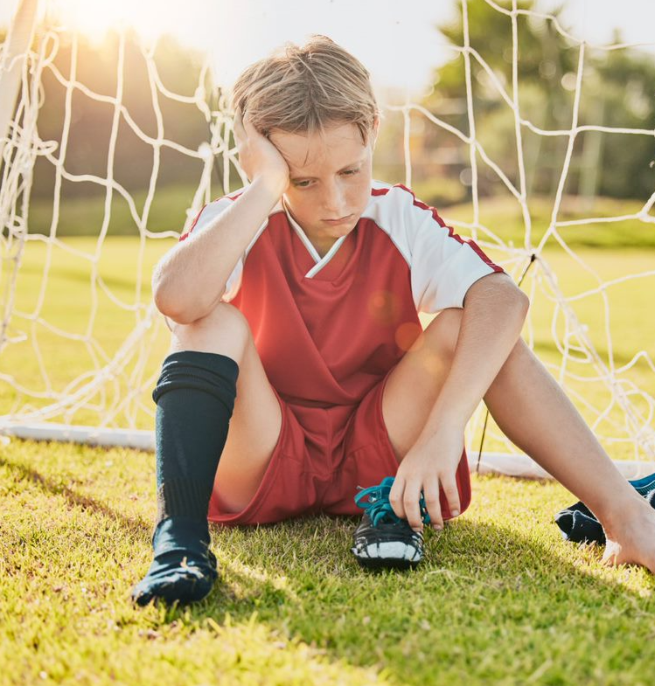
Potential Harms to Children and Young People
Adults entering changerooms whilst children are changing
An adult shoves a child for making a mistake
Young players are forced to train in severe heat
An adult intentionally touches a young person on the backside
A child left alone at the field after training is finished
An adult belittling a child… eg "that was stupid, lift your game!"
An adult texts a child saying "loved your new swimmers today"
An adult alone in a room with a child on an overnight camp
Notes:
NOTE – bulleted text on this slide appears progressively (automatically) after first click
Presenter asks: “Who has witnessed any of these? …… or perhaps some of you may have experienced one or more when you were a child” (allow thinking time and wait for any response/s )

Slide 8
Child Safe Organisation requirements
The head of a child safe organisation must ensure the organisation implements the Child Safe Standards through systems, policies and processes which may include, but are not limited to, the following:
a statement of the organisation’s commitment to child safety
a child safe policy
a code of conduct applying to the following:
(i) Employees (ii) Management
(iii) Contractors (iv) Volunteers
a complaint management policy and procedure
a human resources policy
a risk management plan
a reportable conduct policy
Division 2 Child Safe Standards, Section 8D, Children’s Guardian Act 2019
Notes:
DELETE this slide if you think it’s unnecessary for your audience (or right click on the slide and choose “hide” for your presentation)
NOTE – bulleted text on this slide appears progressively upon clicking
BACKGROUND NOTES - Review/research current available policies/processes in your organisation and perhaps highlight those already existing, or those missing
NOTE - At club level – it is likely that only a club-specific risk management plan will need to be developed. Refer to Child Safe Sport eLearning Module Three (Risk Management)

Slide 9
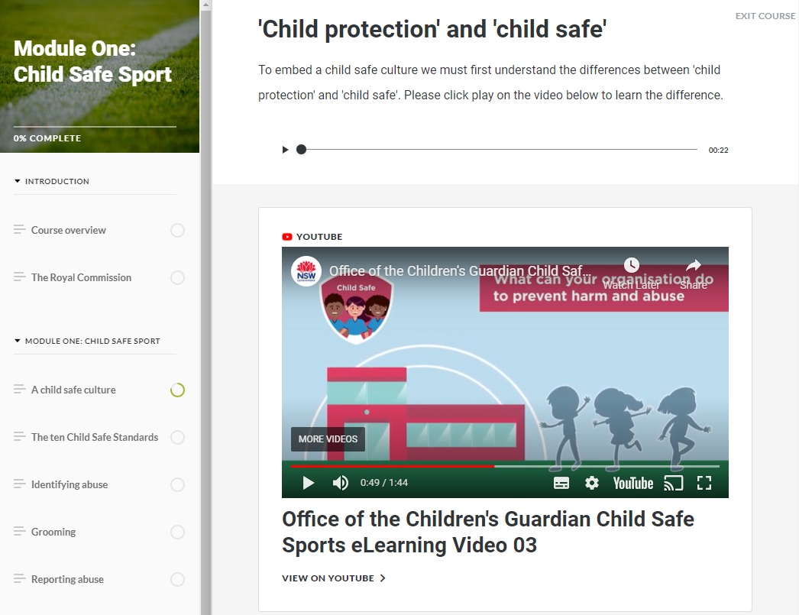
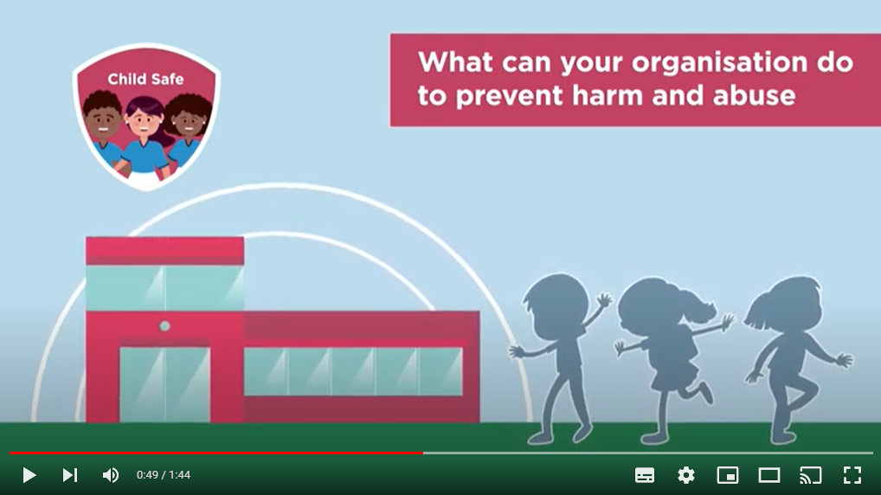
Child Safe Sport eLearning:
Created for all staff and volunteers across all clubs and organisations in NSW
Module One
Child Safe Sport (Introduction)
BASICS in 30 mins
Module Two
Leadership and Policy
Module Three
Risk Management
Module Four
Managing people
Module Five
Incidents and Reporting
Tools and links to demonstrate best practice
Includes take- away resources to support implementation
https://ocg.nsw.gov.au/training-and-resources/elearning
Notes:
NOTE – bulleted text on this slide appears progressively upon clicking (and automatically for 3 RHS points)

Slide 10
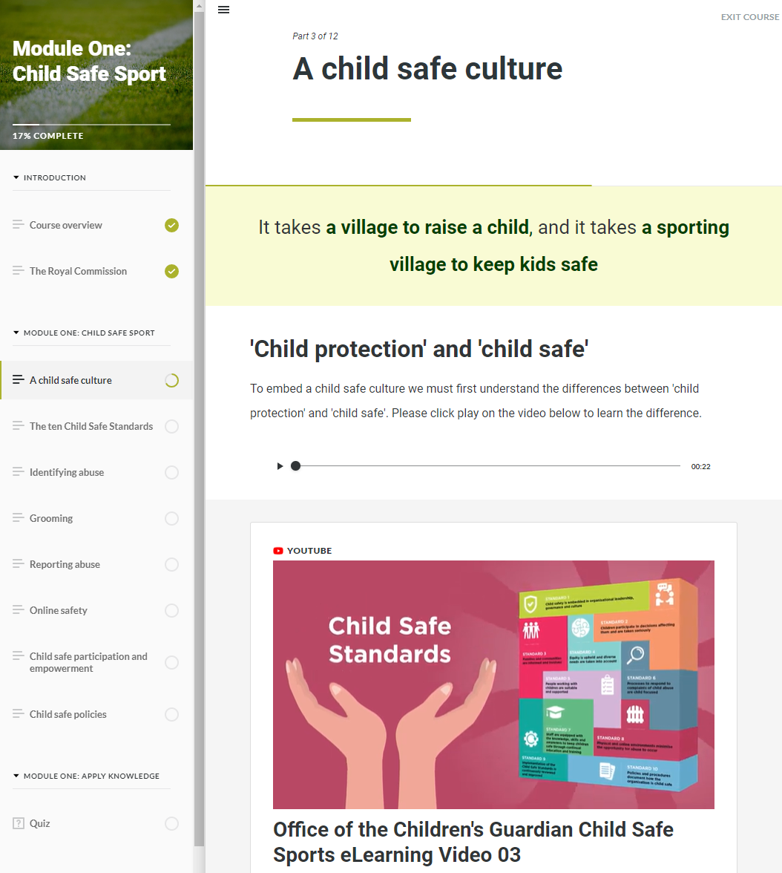
Module One: Child Safe Sport
What’s included?
Suitable for everyone connected to sport & active recreation
Child safe culture
Links to the Standards
Identifying abuse
Grooming
Reporting
Online safety
Child safe participation & empowerment
Child safe policies
Notes:
NOTE – bulleted text on this slide appears progressively (automatically) after initial click

Slide 11
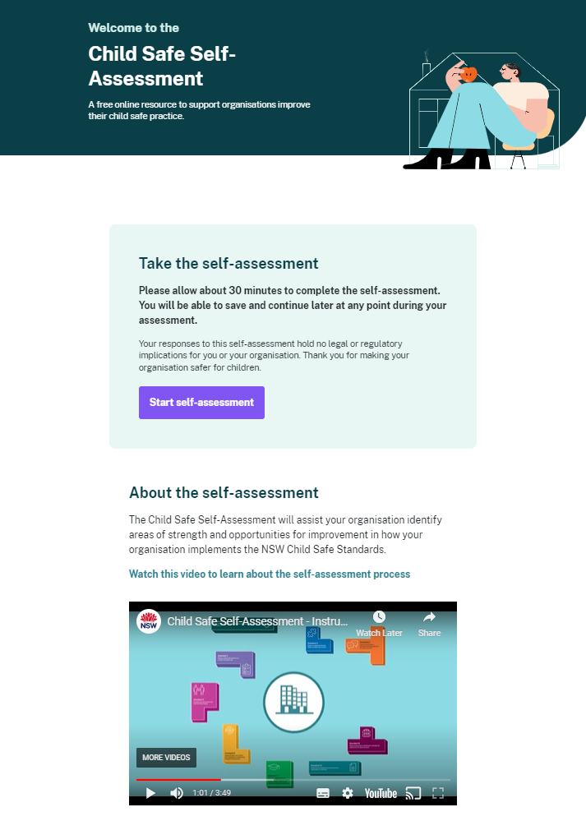
Online Child Safe Self-Assessment Tool
User-friendly, engaging and interactive, and helps child-related organisations to be safer for children.
Simple survey (30 mins) – can be paused, saved and restarted.
Helps organisations meet their legal obligations under the Child Safe Scheme.
https://cssa.ocg.nsw.gov.au
Notes:
NOTE – bulleted text on this slide appears progressively upon clicking

Slide 12
Child Safe Self-Assessment – introductory video
www.youtube.com/watch?v=hp0p3eI4EhU (3m:48s)
Notes:
This video is an important intro to the CSSA

Slide 13
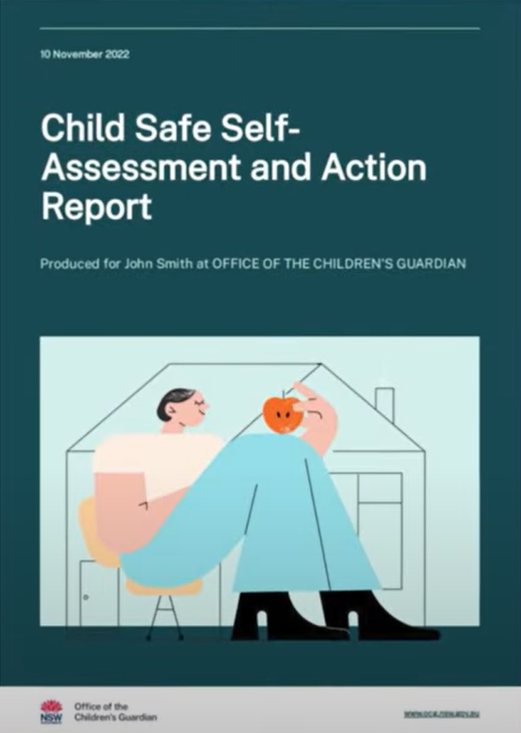
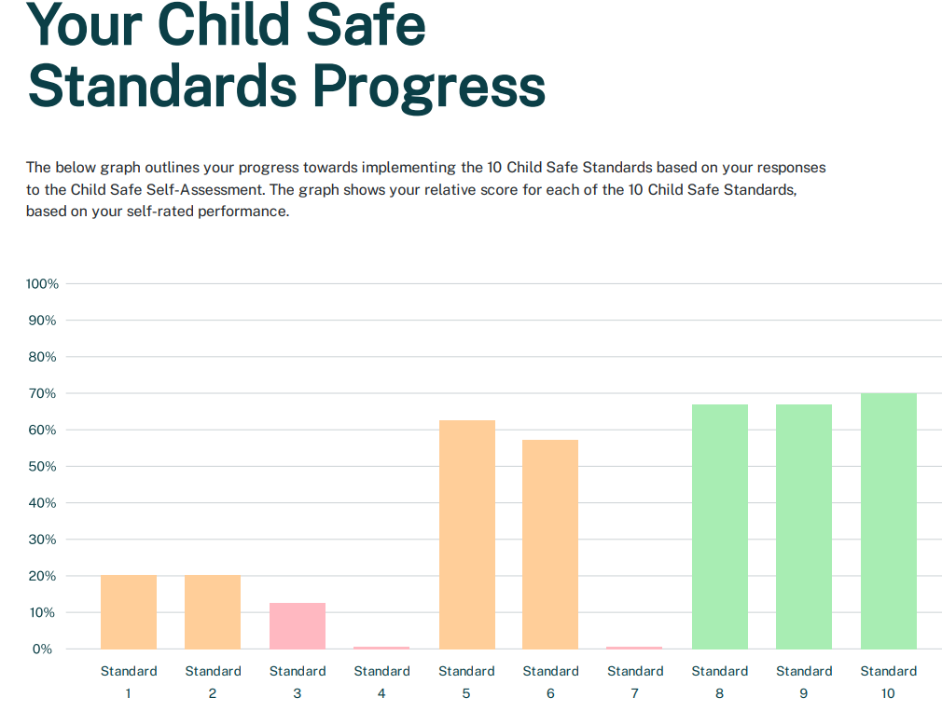
The Child Safe Self-Assessment
Each CSSA produces a tailored Assessment and a practical Action Report to help continue the Child Safe journey
Helps organisations to track their ongoing progress (progressive assessment)
EXAMPLE
Notes:
NOTE – bulleted text and associated images on this slide appear progressively upon clicking

Slide 14
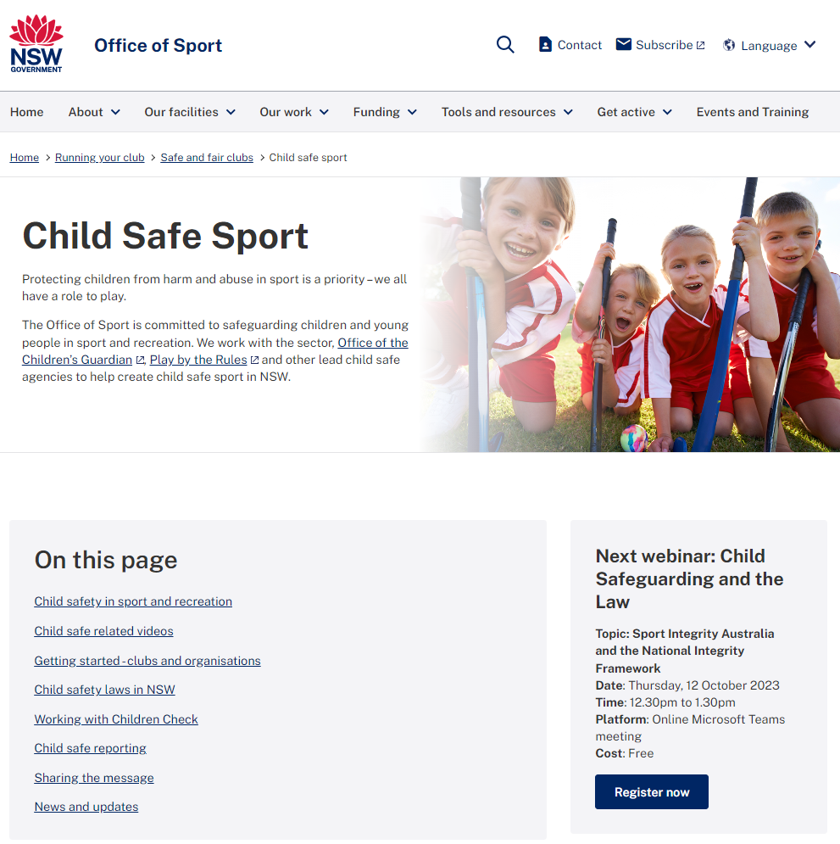
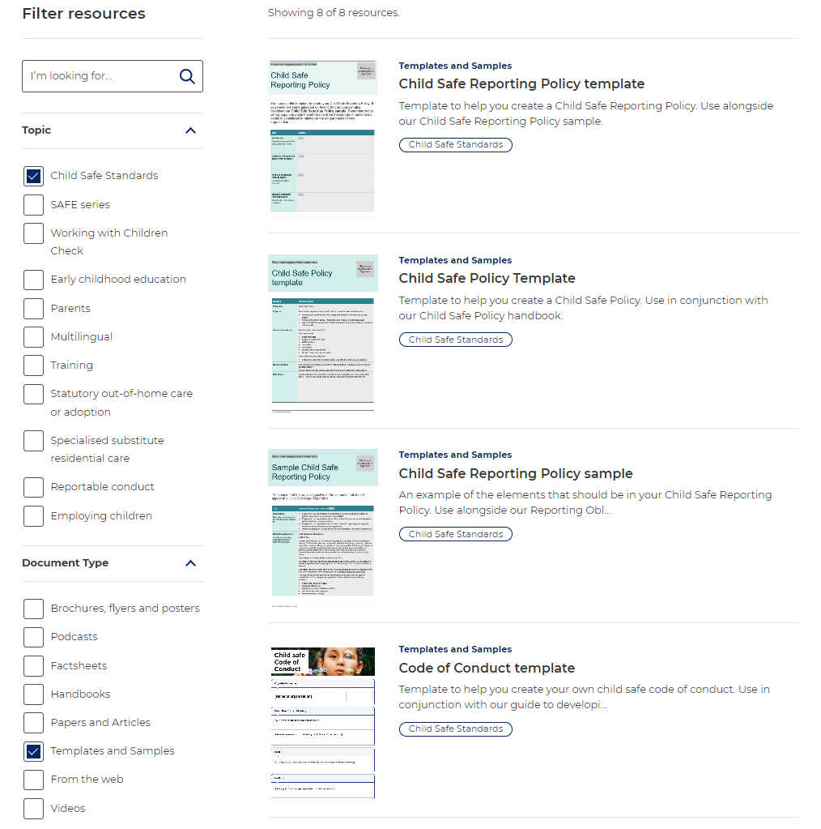
Support available…
Office of Sport
Office of the Children’s Guardian
www.sport.nsw.gov.au/running-your-club/safe-and-fair-clubs/child-safe-sport
https://ocg.nsw.gov.au/our-resources

Slide 15
Next steps…
Complete Child Safe Sport eLearning Module One
Complete your/our first “baseline” Child Safe Self-Assessment (CSSA)
Continue with implementation actions and monitoring progressive CSSA results
Subscribe to the Office of the Children’s Guardian’s Sport Newsletter
Notes:
NOTE – bulleted text on this slide appears progressively upon clicking

Slide 16
Thankyou / summary / questions
Optional - footer information (Child Safe Sport implementation – membership presentation)
Notes:
DELETE this slide if you think it’s unnecessary for your audience (or right click on the slide and choose “hide” for your presentation)

Slide 17
