Slide 1


Organisation Support Program (OSP)
Succession Planning for SSO Boards
November 2024
Notes:
Welcome everyone and thank you for joining us today for this information session on Succession Planning for SSO Boards. I am Russel Grimson, Manager Sector Capability, & I am introducing today’s session. Today we welcome Jenny Robertson from Board Matters who will be giving us practical advice on how you can effectively introduce succession planning into your Governance practices.
Before we start, here are a few housekeeping points.
As we have quite a few people on the call, we have muted everyone’s camera and microphone to assist with a smooth presentation.
Similarly, we’ve also turned off the hand-raise and “React” functions – but we encourage you to ask your questions in the “Chat”. We will endeavour to respond to any questions during the session.
We will be recording today’s presentation & it will be made available on the OSP page of the Office of Sport website later this week.

Slide 2
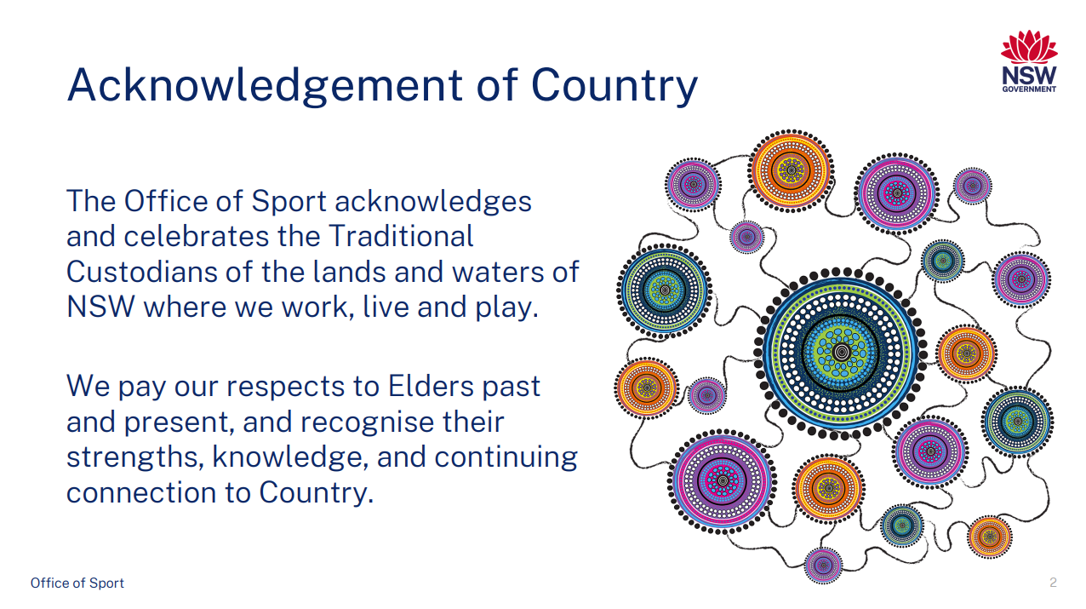
Notes:
Before we commence, I would like to make an acknowledgement of Country.
The Office of Sport acknowledges & celebrates the Traditional Custodians of the lands & waters of NSW where we work, live & play.
We pay our respects to Elders past & present, & recognise their strengths, knowledge, & continuing connection to country.

Slide 3
Background – Succession Planning
Sports Governance Standards Survey – Succession Planning (Priority in NSW)
Support to achieve Gender Equity in Sports Governance
Notes:
Slide 3 – contents & Admin
Today’s session will focus on Succession Planning for your Board. The reason for this focus is twofold:
The results of the Sports Governance Standards Survey in 23/24 highlighted that succession planning was an area of development across the sector; &
Success Planning can be a key process in assisting your organisation to achieve Gender Equity in Sports Governance targets.
We are delighted to welcome Jennifer Robertson, managing Director of Board Matters, to share her advice on the topic.
Jennifer is a practicing lawyer, governance consultant and company director with over 25 years experience in the field. Her board appointments include statutory bodies, public authorities, an APRA regulated superannuation fund, an ASIC regulated financial planning entity and many not-for-profit organisations.”
Welcome Jennifer

Slide 4
NSW Office of Sport
OSP Webinar: Succession planning for SSO Boards
®
Wednesday, 27 November 2024
Jennifer Robertson, Managing Director
j.robertson@boardmatters.com.au
www.boardmatters.com.au
© Board Matters (2024)

Slide 5

© Board Matters (2024)

Slide 6

Succession planning?
The aim: Having an optimal mix of people, skills and knowledge to ensure your SSO’s ongoing success whether on the Board or in the exec
The what: Refreshing your SSO’s leaders (governance or executive) in order to continue to meet the challenges your SSO faces
The how: Having the process documented!
The ultimate goal: is to have the right person able to fill the right vacancy at the right time
© Board Matters (2024)
Notes:
have a documented process
have a system that looks to retain the right amount of corporate knowledge

Slide 7



The (typical) different areas of governance leadership succession planning
Board Succession Planning
Directors
Board Chair
Committee Chair(s)
Committee Members
CEO Succession Planning
As the Board’s only employee
*NB. dependent on your SSO’s structure
Executive Succession Management
CEO’s role for management
Developing a pipeline of talent for key personnel
Succession planning should be the occasion of revitalisation, refresh and celebration!
© Board Matters (2024)
Notes:
Reinforce: that succession planning should be the occasion of revitalisation, refresh and celebration. It is often one of the hardest conversions to have but also one of the most necessary for any board

Slide 8
The different roles at play to support succession planning efforts
At a glance: it’s a top-down approach
Board
Establishes the approach that supports your SSO’s succession planning needs
Documents these processes into a board-level policy (incl. Board, CEO, Executive)
Creates a composition and skills matrix to identify gaps in skills/expertise
Oversights the management and implementation of succession activities (incl. recruitment)
Fosters a culture of continual succession engagement (not an on-the-shelf policy)
Regularly schedules discusses about succession planning activities at board-level
CEO &
Executive Team
Implements delegated processes and activities of the policy
Develops a pipeline of talent for key personnel roles (SSO dependent)
Encourages a culture of open conversation about succession planning and development opportunities
© Board Matters (2024)

Slide 9

Chat room break:
Pre-Question prompt:
What are your current barriers and challenges preventing good succession planning for your SSO Board?
“Convincing long-serving directors to retire from the board can be difficult where there is no policy or constitutional reason for doing so”
J Beck and J Tunny (2014)
© Board Matters (2024)
Notes:
- may include market environment, volunteerism, time-poor, compensation etc
Ie. . It is often one of the hardest conversions to have but also one of the most necessary for any board

Slide 10
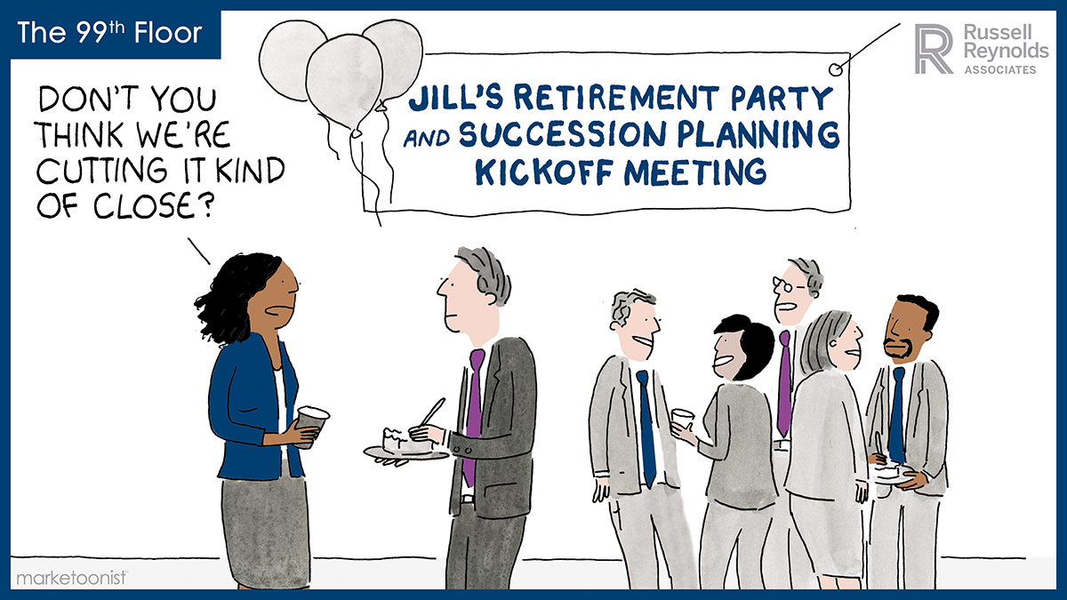
How succession planning often feels…

Slide 11
Forward-looking boards and their succession planning
“With the rising demand in highly-specialized skillsets – digital transformation, cybersecurity, sustainability, M&A – the war for board-ready talent is real, and fierce,” she says. “Coupled with the diversity element, boards should be thinking about renewal and refreshment with at least a five-year lens.
– Cathy Logue, Managing Partner, Global Leader of the CFO Practice Group, Stanton Chase Toronto
“Succession planning is no longer just a box to tick or a ‘nice to have’ when looking at board governance. It is an integral part of effective supervision and stewardship, indelibly linked to core board responsibilities such as oversight of strategy implementation and risk management.
- James Beasley, Senior Director, Head of Board Advisory, Europe, Middle East, and Africa, Nasdaq
© Board Matters (2024)
Notes:
The context in which companies operate today has been dramatically transformed by unprecedented circumstances including, but not limited to, climate change, diversity, equity, and inclusion, as well as the impact of the COVID-19 global pandemic. Moreover, companies today have also shifted to focus on stakeholder capitalism; meaning shareholder interests are having to be balanced with those of other stakeholder groups such as customers, employees and society as a whole.
One of the worst mistakes a board can make is not looking beyond its traditional networks and unconscious biases. “The standard excuse of ‘We couldn’t find any qualified diverse board candidates’ just doesn’t fly anymore,” says Logue. “Investors are putting their foot down, and boards must approach renewal and succession planning more creatively,” she notes.
Boards can demonstrate forward-thinking by constructing and nurturing a succession plan that authentically reflects the company’s culture and strategic vision. There is no time to sit idle.
Forward-looking boards are well equipped to manage this. These boards make an ongoing commitment to understanding company risks and opportunities, culture, values, and strategic vision, and remain apprised of the latest corporate governance best practices.

Slide 12
What does good succession planning look like for SSO Boards
Principle 9.8 of the Australian Sports Commission SGS:
“The board has a documented succession planning process for key personnel and the retention of corporate knowledge”
Self-Assessment Rating Scale: | 1 – The board does not have a succession plans in place for key personnel | 2 – The board has succession plans in place for key personnel | 3 – The board regularly reviews the succession plans for key personnel | 4 – The board regularly reviews the succession plans for key personal and allocates time at board meetings to discuss and refine these plans
But how do you move from a 1-2 to a 3-4?
© Board Matters (2024)

Slide 13
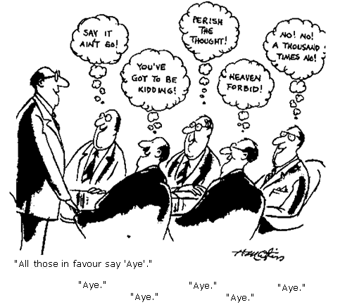
Key Capability: What is ‘best practice’?
‘Best practice’?
Attendance
Equity stake
Skills
Age limits
CEO on board
Board size
Director-only sessions
…Useful, but not enough.
Notes:
“No broad pattern of incompetence or corruption”.
Most failures (Enron, Worldcom) followed accepted practices at the time.

Slide 14
Key Capability: An ideal setting
The ideal board
Diversity
Board and Chair succession
Influencing the appointor
  End goal:
  Better decision-making
  Skills
  Background
  Demographics
  Tenure
  Representative or Balanced selection
  End goal: Continuous effective board leadership
  End goal: Achieving a balanced board
© Board Matters (2024)

Slide 15
What areas of good governance performance helps support effective succession planning?
Strategic planning
Values, mission and purpose
Board recruitment practices
Board induction processes
Important to remember that succession planning is not a siloed activity
It is informed by many other areas of good governance practices and performance
Risk management and registers
Board composition diversity targets
Board development and education
Board skills matrix
Constitutional terms and tenures
© Board Matters (2024)

Slide 16
But how do you practice good succession planning?
Key tenements to inform good succession practices
Define: Clearly define the key roles, responsibilities and owners of succession planning
Targets:
Set what your ‘ideal’ settings are diversity and mix
Document: Develop a succession policy that fits your SSO’s needs
Approach: Embed a top-down approach to strategise and inform the right tone
Map: Articulate how your SSO Board plans to implement and achieve its targets
Review: Regularly discuss and undertake reviews of plans and monitor through risk registers
© Board Matters (2024)
Source: AICD (2024) ‘Not-For-Profit Governance Principles: Third Edition’
Notes:
Key tenements to inform good succession practices
Define: Clearly define the key roles, responsibilities and owners of succession planning (and delegations where appropriate)
Approach: Embed a top-down approach to strategise and inform the right cultural tone to succession from the Board
Targets: Set what your ‘ideal’ settings are for targets and goals for diversity and mix (this is not a barrier!)
Map: Articulate how your SSO Board plans to implement and achieve its targets whilst balancing the need for refreshment and that of retaining corporate knowledge
Document: Develop a succession policy that fits your SSO’s needs and how it will manage its implementation (the earlier the better!)
Review: Regularly undertake reviews of the plans and processes (Are they working well? Do they need to change?

Slide 17
What practical steps can SSO’s adopt to enhance succession planning practices?
Get the alignment right
Values
Strategic discussion
Create a risk profile (likelihood + impact)
Assess current health
Understand the structural context
(those that are fixed and those which are not)
Constitutional guidance
Policy
Skills matrix
Nominations Committee
Agenda item
© Board Matters (2024)
Notes:
A running list of techniques to uplift succession planning practices – these can be expanded upon in the Guide/Factsheet as options for a checklist:
Can use the OoS Policy Template and highlight key areas, such as pipeline development and emergency leadership vacancies

Slide 18
Example: A simple board skills matrix
 | A. TECHNICAL COMPETENCIES/SKILLS
 | Strategy | Financial | Legal | Risk and compliance | Governance | IT and Data | Capital management | Human Resources | Marketing and Communications | Environment and sustainability | Community relations | Government and Policy
[Example] | 2 | 3 | 2 | 3 | 1 | 1 | 3 | 1 | 2 | 2 | 1 | 1
Director 1
Director 2
Director 3
Director 4
Director 5
Skill Assessment Scale: | Level 1 – Developing competency | Leve 2 – Competent | Level 3 – Highly competent
Part B should include personal characteristics and behaviour attributes (ie. gender, age, geo, and more)
© Board Matters (2024)

Slide 19


Your succession planning checklist
Know your Constitutional settings
  Review and understand your Constitution. What does it say in relation to:
    Terms (years between director elections) and tenures (collective number of terms)
    Appointment methods and rules
    Board size and minimum number of directors
    Board and committee structures
  Monitor re-election and tenure cycles
2. Understand and manage:
  The risk of individuals becoming entrenched in roles​
  The potential loss of skills, knowledge and organisational history​
  Key person risks and how you mitigate them​
  The length of each Director’s commitment and how to supersede outgoing Directors
  The scenarios involving emergency/interim succession planning
  External expectations such as the inclusion of the stakeholder voice on the Board
© Board Matters (2024)
Notes:
To meet best practice standards, boards should regularly consider their composition with respect to expertise, skillset, background, and more. This can help ensure an appropriate mix of skills and attributes uniquely suited to their organisation, as well as help identify possible gaps that may need to be addressed.
However, ‘moment in time’ assessments of board composition are insufficient to determine whether a board is fit for purpose. Hence, for companies taking a long view, succession planning should be a continuous process and a top priority on boards’ and stakeholders’ agendas.
Forward-looking boards focus on long-term strategy and sustainable value creation. A robust, long-term succession plan considers the board’s current skills and those it’s likely to need in the future.
While board turnover is on the minds of many directors, the latest Annual Corporate Directors Survey found that few boards are making succession planning a priority.3 Ten percent of directors reported that their board doesn’t have a succession plan at all, and 33% said it is ad hoc. For boards that do have a plan, it is shared with the full board less than half the time (49%).
A robust approach to succession planning, from the board down, can serve not only to ensure a strong leadership and talent pipeline, but also to inspire employees and other stakeholders with confidence in the board’s diligent leadership.
At the board level, good succession planning aims to deliver consistently relevant and impactful board composition, an important component of which is cognitive diversity. Investors are placing increased focus on board composition—including diversity—and the implementation of structured board succession planning.

Slide 20


Your succession planning checklist
3. Decide on processes
  Set aside the time to discuss your SSO’s ‘ideal settings’ look like (incl. strategic plans, composition and diversity, etc)
  Agree on the approach going forward – who is involved? (ie. nominations committee, internal/external recruitment)
  Develop a Board Succession Policy and Board Skills Matrix that enlivens your unique settings – what are your timelines? (ie. established terms or staggering?)
4. Embedding succession planning into BAU
  Effective boards are proactive rather than reactive: develop and actively maintain a succession plan for your board
  Chair to schedule annual succession planning discussions with each Director
  Add to the Board’s agenda as a standing item and/or schedule board discussions to consider this regularly
  Where possible, focus on fostering and nurturing the next generation of talent through programs/committee work
© Board Matters (2024)
Notes:
To meet best practice standards, boards should regularly consider their composition with respect to expertise, skillset, background, and more. This can help ensure an appropriate mix of skills and attributes uniquely suited to their organisation, as well as help identify possible gaps that may need to be addressed.
However, ‘moment in time’ assessments of board composition are insufficient to determine whether a board is fit for purpose. Hence, for companies taking a long view, succession planning should be a continuous process and a top priority on boards’ and stakeholders’ agendas.
Forward-looking boards focus on long-term strategy and sustainable value creation. A robust, long-term succession plan considers the board’s current skills and those it’s likely to need in the future.
While board turnover is on the minds of many directors, the latest Annual Corporate Directors Survey found that few boards are making succession planning a priority.3 Ten percent of directors reported that their board doesn’t have a succession plan at all, and 33% said it is ad hoc. For boards that do have a plan, it is shared with the full board less than half the time (49%).
A robust approach to succession planning, from the board down, can serve not only to ensure a strong leadership and talent pipeline, but also to inspire employees and other stakeholders with confidence in the board’s diligent leadership.
At the board level, good succession planning aims to deliver consistently relevant and impactful board composition, an important component of which is cognitive diversity. Investors are placing increased focus on board composition—including diversity—and the implementation of structured board succession planning.

Slide 21


Your succession planning checklist
5. Own the planning
  Develop/regularly (at least annually) review the Board Skills and Competencies matrix
  Established committees ought to review required skills, identify gaps, develop transparent appointment criteria, and inform and update succession plans periodically
  Implement professional development plans for the Board
  Introduce succession planning practices in induction activities
  Include succession planning topics in board effectiveness evaluations
  (for SSOs: see Principle 9.8 of the SGS)
6. Review and re-evaluate (against strategic plans and values)
  Consider targeted recruitment techniques through identified skill gaps and needs, diversity targets, and other focuses as they relate to your SSO’s goals
  (It is just as crucial to set a strategic plan, as it is to make sure you have the right people, skills and expertise to achieve it!)
  Review the performance of processes to ensure learnings can be uplifted to support future practices
  Reflect on the purpose and values of your SSO (in the now, and for the future)
© Board Matters (2024)
Notes:
To meet best practice standards, boards should regularly consider their composition with respect to expertise, skillset, background, and more. This can help ensure an appropriate mix of skills and attributes uniquely suited to their companies, as well as help identify possible gaps that may need to be addressed.
However, ‘moment in time’ assessments of board composition are insufficient to determine whether a board is fit for purpose. Hence, for companies taking a long view, succession planning should be a continuous process and a top priority on boards’ and stakeholders’ agendas.
Forward-looking boards focus on long-term strategy and sustainable value creation. A robust, long-term succession plan considers the board’s current skills and those it’s likely to need in the future.
While board turnover is on the minds of many directors, the latest Annual Corporate Directors Survey found that few boards are making succession planning a priority.3 Ten percent of directors reported that their board doesn’t have a succession plan at all, and 33% said it is ad hoc. For boards that do have a plan, it is shared with the full board less than half the time (49%).
A robust approach to succession planning, from the board down, can serve not only to ensure a strong leadership and talent pipeline, but also to inspire employees and other stakeholders with confidence in the board’s diligent leadership.
At the board level, good succession planning aims to deliver consistently relevant and impactful board composition, an important component of which is cognitive diversity. Investors are placing increased focus on board composition—including diversity—and the implementation of structured board succession planning.

Slide 22
Chat room break:
Pre-Question prompt:
What are your key takeaways from our session today?
What actions can you see for your SSO Board moving forward regarding your own unique succession planning goals?
© Board Matters (2024)

Slide 23

Q&A
© Board Matters (2024)

Slide 24


®
Thank You!
Need further tailored assistance or have more questions?
Get in touch with us!
Jennifer Robertson
Managing Director
j.robertson@boardmatters.com.au
www.boardmatters.com.au
© Board Matters (2024)

Slide 25
Please refer questions to:
Russel Grimson
Manager, Sector Capability & Performance russel.grimson@sport.nsw.gov.au or sectorcapability@sport.nsw.gov.au
Office of Sport
Notes:
Slide 28 – Questions
Thank you for attending our OSP information session.
A quick reminder, a recording of today’s session & slides will be uploaded to the OSP page on the Office of Sport website this week.
If you have any questions about OSP, please feel free to contact our team on 13 13 02 or at sectorcapability@sport.nsw.gov.au.
Have a great afternoon.

