Slide 1


The Duke of Edinburgh’s International Award
Duke of Ed Centre’s
Name
Presenter’s Name
Presenter’s Title
Date

Slide 2



WHY USE THE DUKE OF ED?
The Duke of Ed is a global youth development Framework empowering young Australians aged 14 – 24 to explore their full potential.
All young people in Australia, from every background and life circumstance, have the opportunity to be equipped as individuals to succeed in life.
Notes:
The Duke of Edinburgh’s International Award is the world’s leading accreditation Framework used by schools and other organisations to support young people to achieve their non-formal education goals.
It aims to provide every young Australian with the opportunity for a positive and rewarding journey of self-discovery and equip them as individuals to succeed in life.

Slide 3


Slide 4
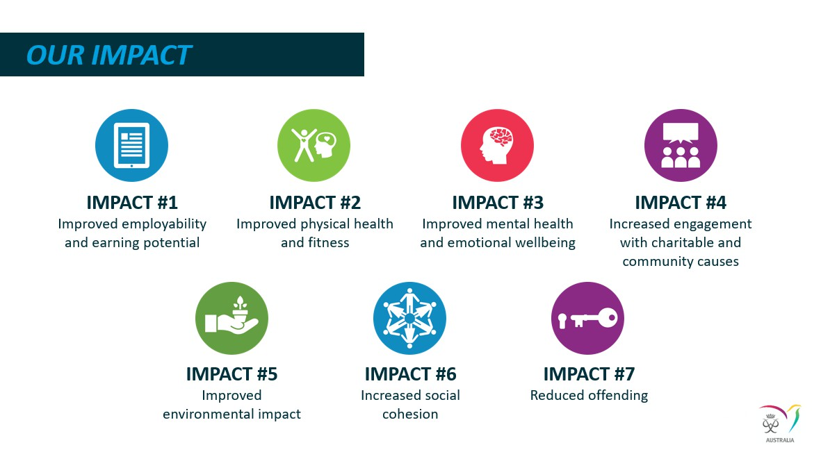
Notes:
Some of the impacts noted include:
Improved employability
Improved physical and mental health
Increased engagement with community and social cohesion

Slide 5
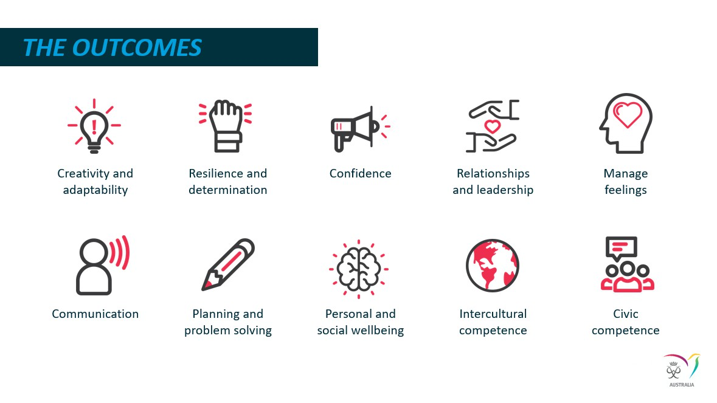
Notes:
What are some of the proven outcomes noted from using the Duke of Ed Framework
Creativity & adaptability, Resilience, Confidence, Communication, Planning and Problem Solving

Slide 6
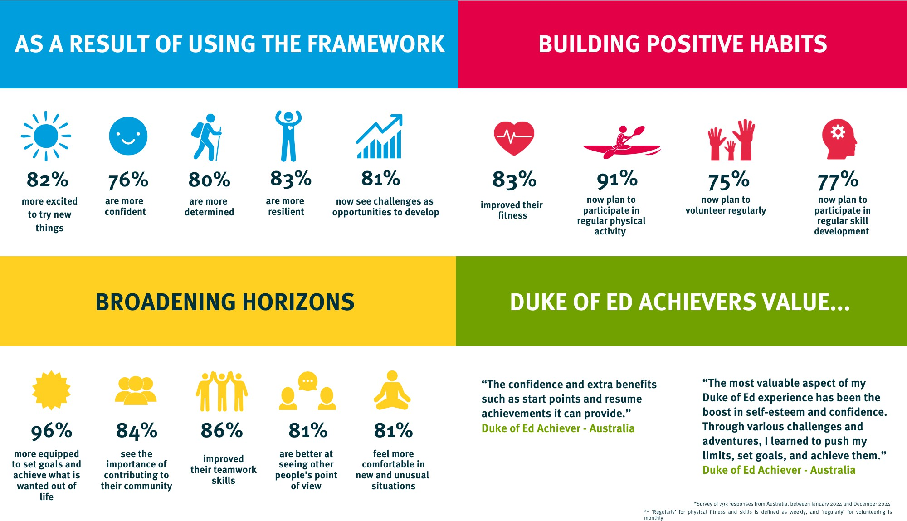

THE DUKE OF ED IN NUMBERS
Notes:
The Duke of Ed International Foundation conducted a survey in 2024 across the globe with 793 students from Australia participating in the survey.
Some of the highest ranked outcomes include:
81% believe they now see challenges as opportunities to develop since using the Framework.
91% now plan to participate in regular physical activity
And 96% feel more equipped to set goals and achieve what they want out of life

Slide 7
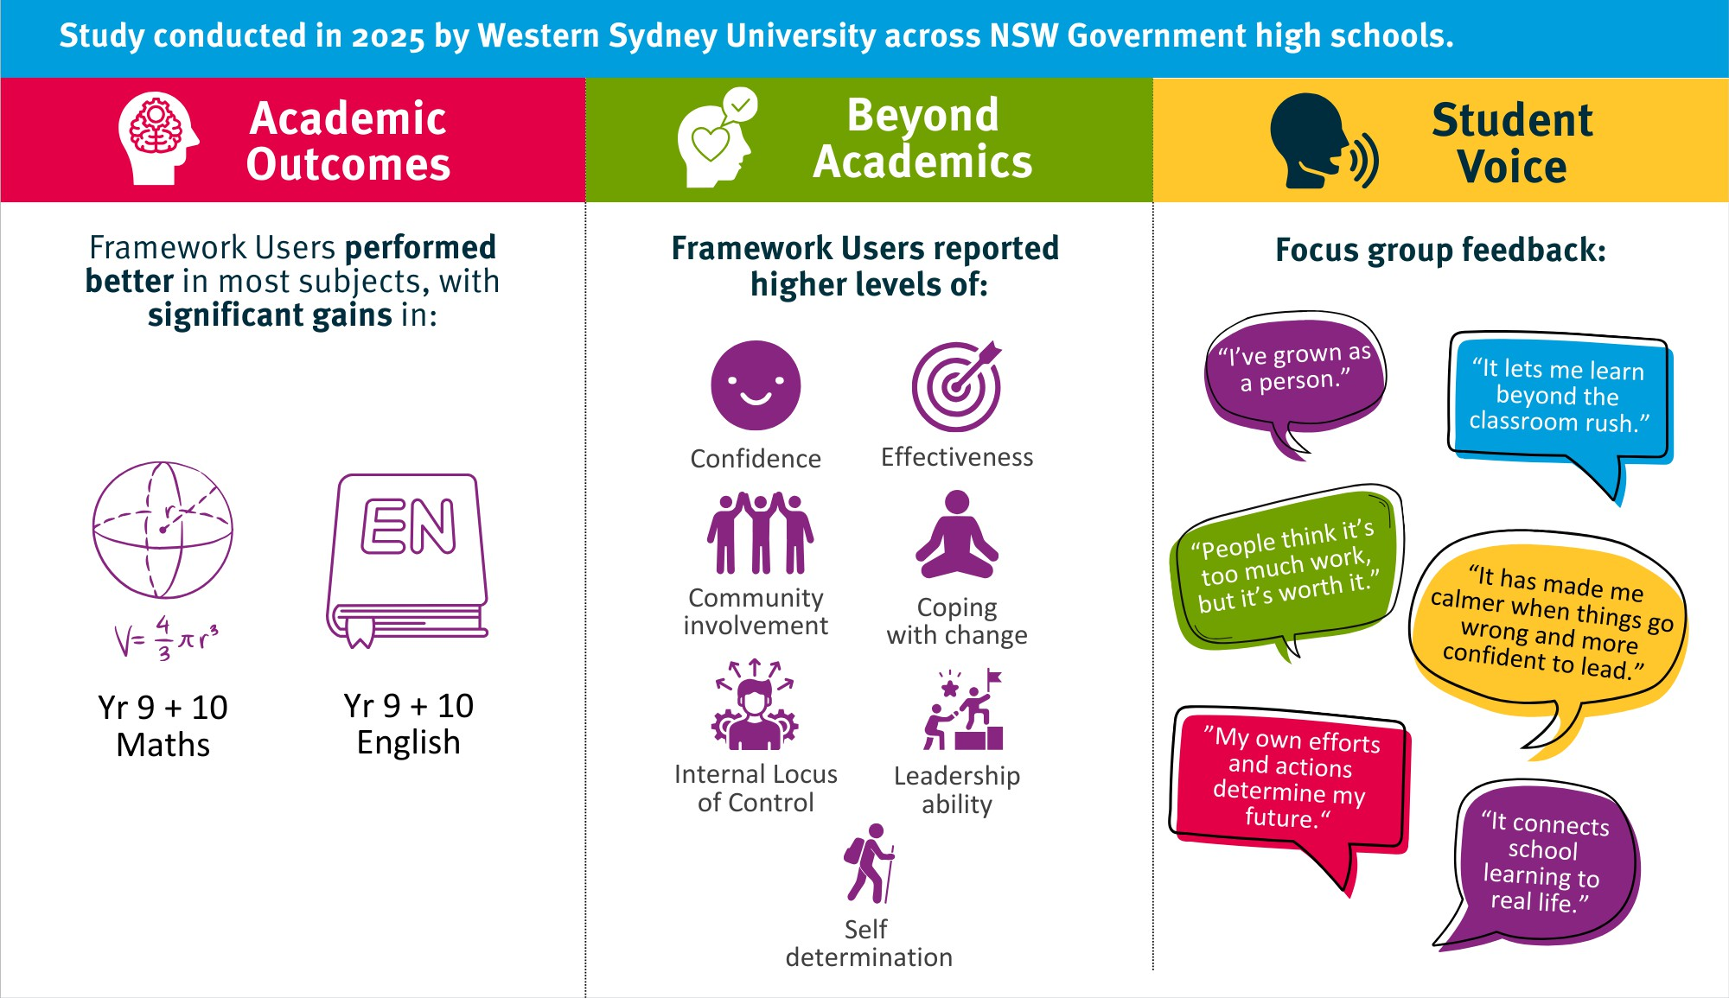
THE DUKE OF ED ADVANTAGE
Students using the Framework outperform peers academically, personally + socially
Notes:
In 2025 Western Sydney University conducted a survey across a range of Government High Schools.
Some of the findings include:
Higher performance in Yr 9 & 10 Maths and English
Higher levels of confidence, self-determination and coping with change

Slide 8
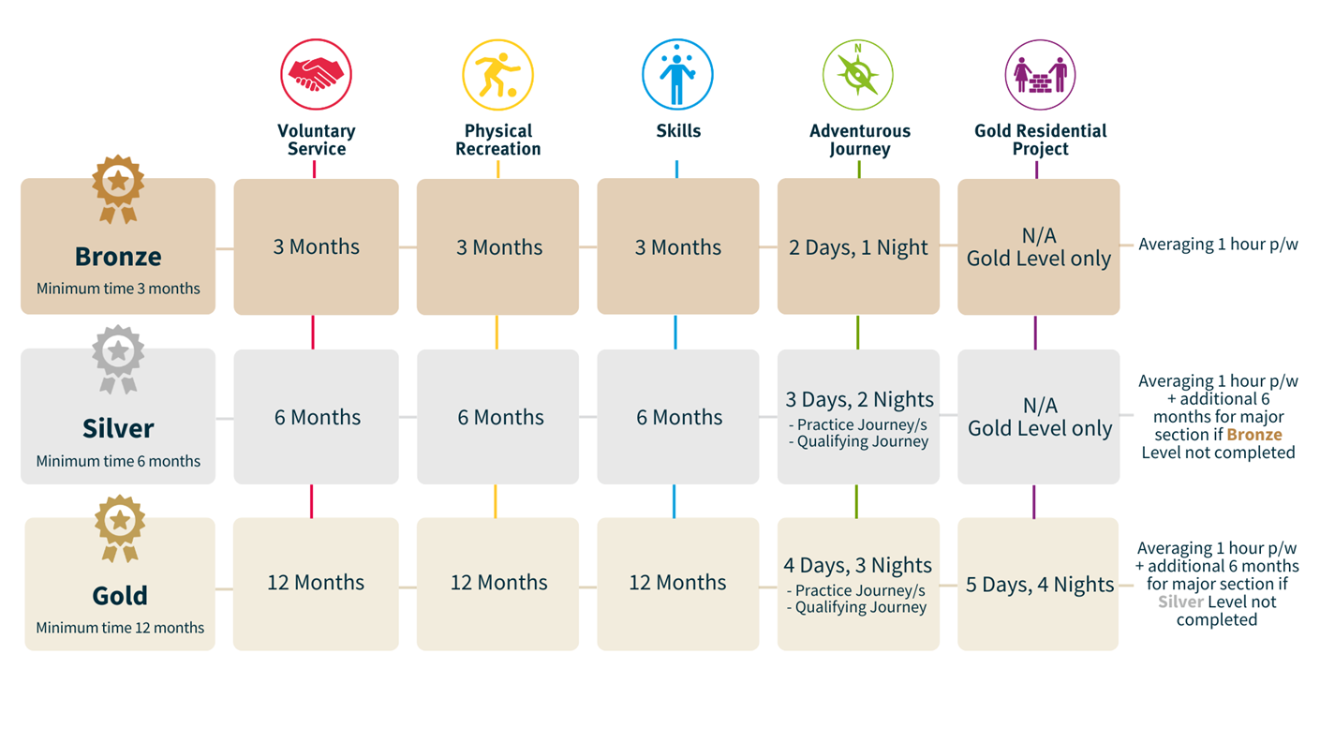

THE DUKE OF ED FRAMEWORK
Regular Sections require regular participation, averaging at least:
One hour per week
Two hours per two-week period
Three hours per three-week period
Four hours per four-week period
Notes:
The Duke of Ed Framework consists of 3 Levels: Bronze, Silver & Gold
The Bronze Level has a minimum time requirement of 13 weeks and students need to log 1 hour per week in each Section. To assist with the time commitment, 75% of activities in the Bronze Level can be done inside school time. For example cooking or woodwork for Skills, school sports for Phys Rec or volunteering in the school community for Voluntary Service.
As well as an increase in the time commitment for Silver and Gold Levels, only 50% of activities can be done in school time. The other 50% must be done in their own time.

Slide 9
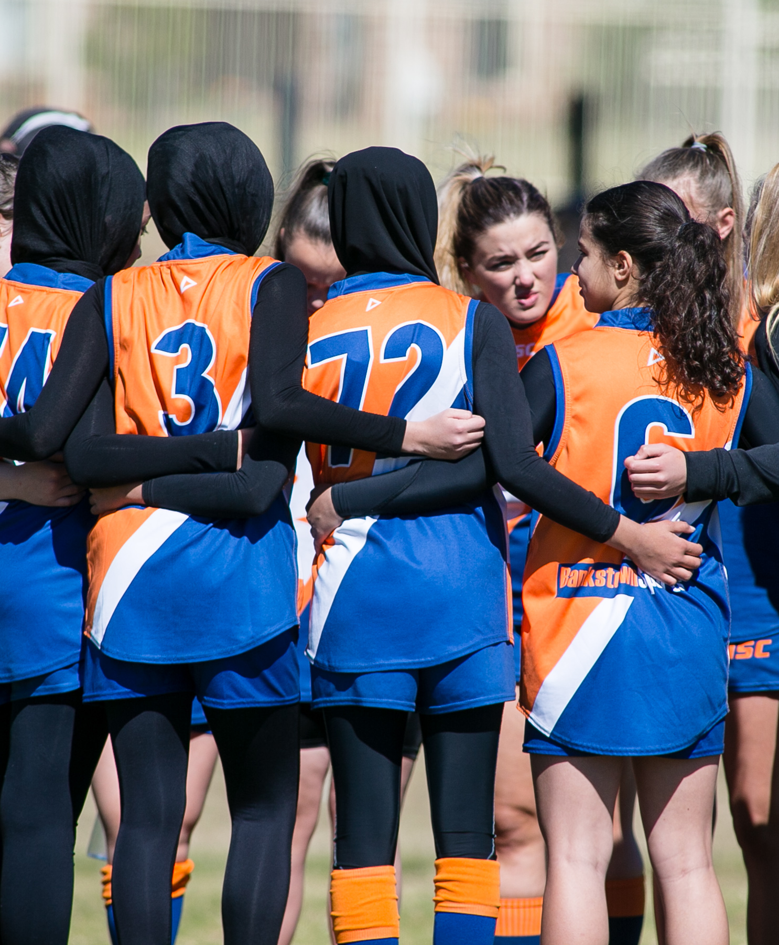
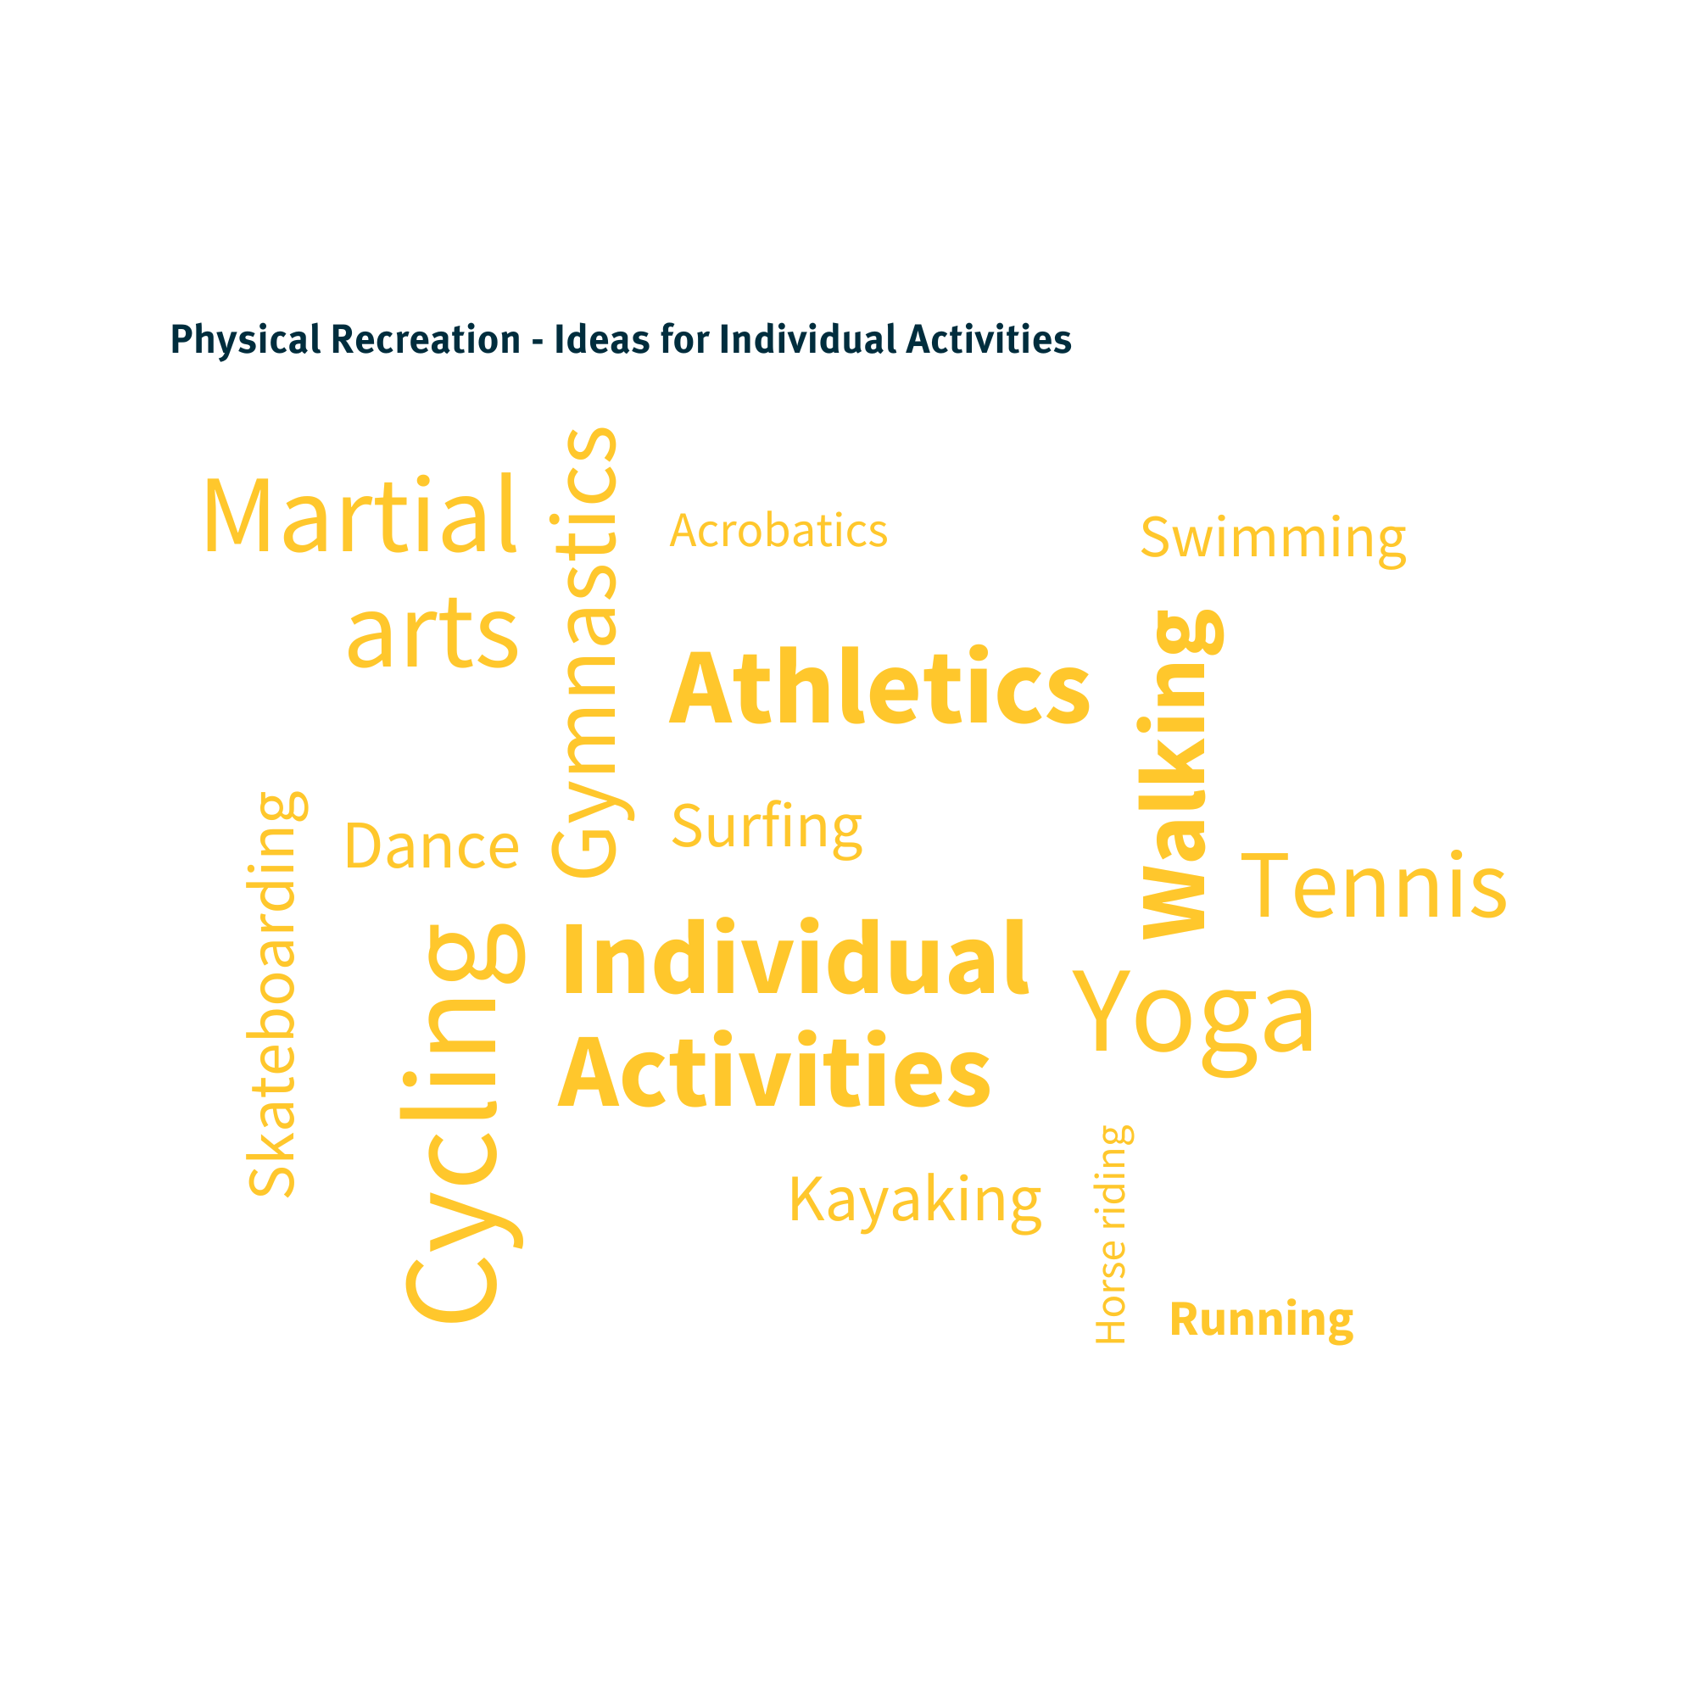

PHYSICAL RECREATION
Notes:
Good opportunity to interact with audience

Slide 10
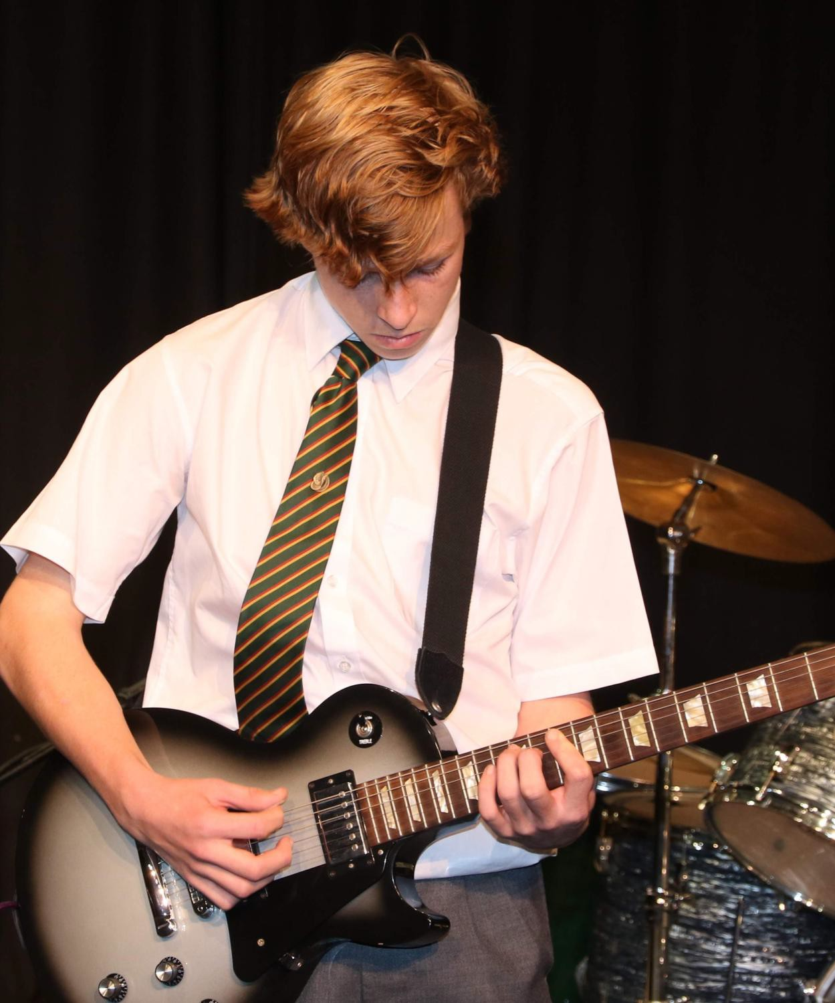

SKILLS
Notes:
Good opportunity to interact with audience

Slide 11

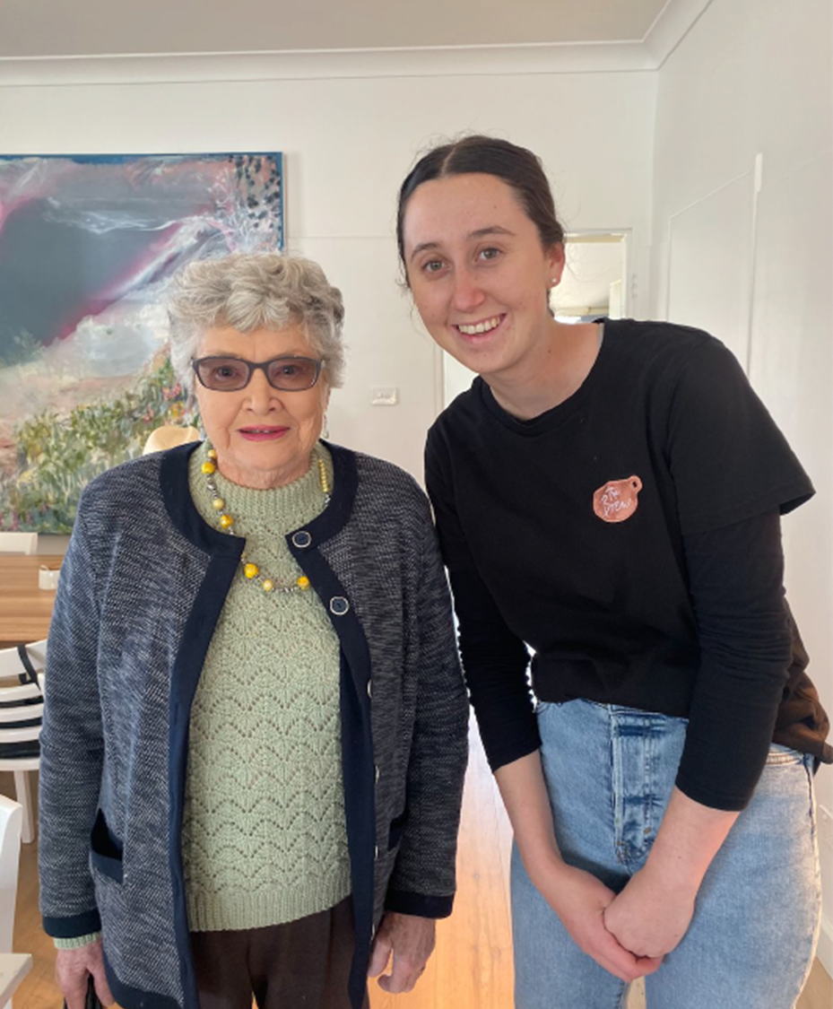
VOLUNTARY SERVICE
Notes:
Good opportunity to interact with audience

Slide 12
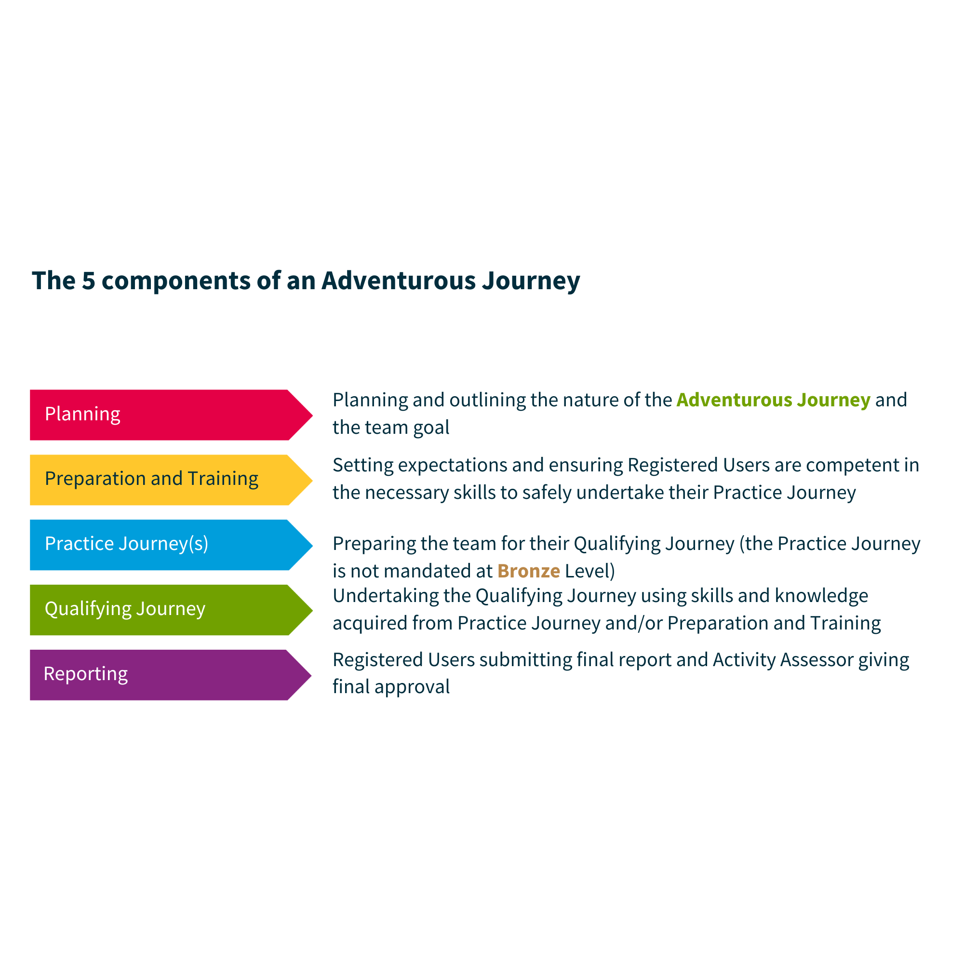
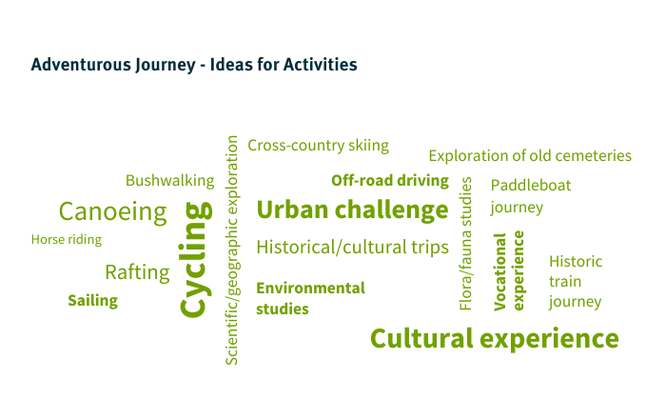

ADVENTUROUS JOURNEY
Notes:
Explain there is prep and training, a practice journey and a qualifying journey.
Remember, you do not need to conduct a Practice Journey at the Bronze Level, but if you chose to, please remove the reference on the slide.
Can update the picture to include your previous Duke of Ed Users on their AJ.

Slide 13
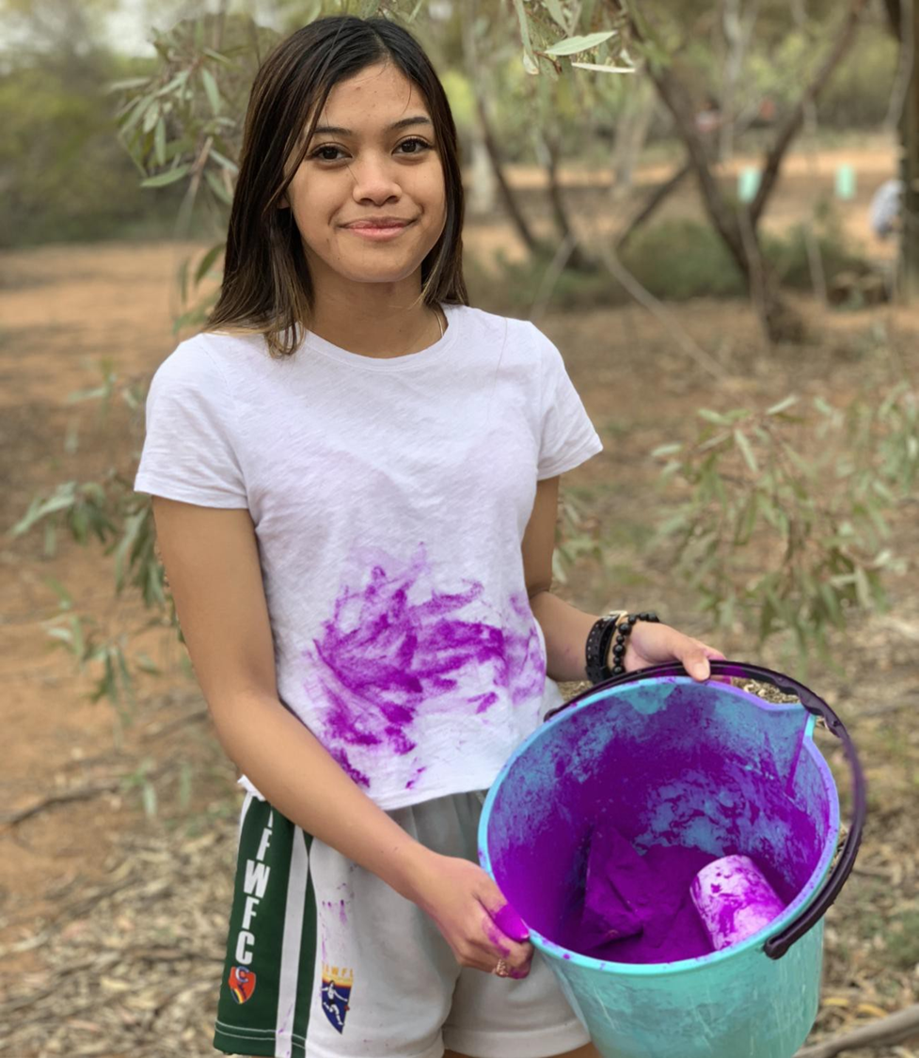
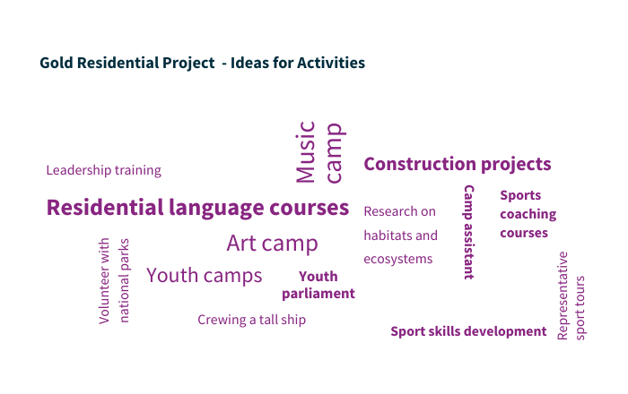
GOLD RESIDENTIAL PROJECT
Notes:
To broaden experience through involvement with others in a residential setting.
The Gold Residential Project offers a Registered User a unique experience that will broaden their horizons, challenge their outlook, and extend their comfort zone.

Slide 14
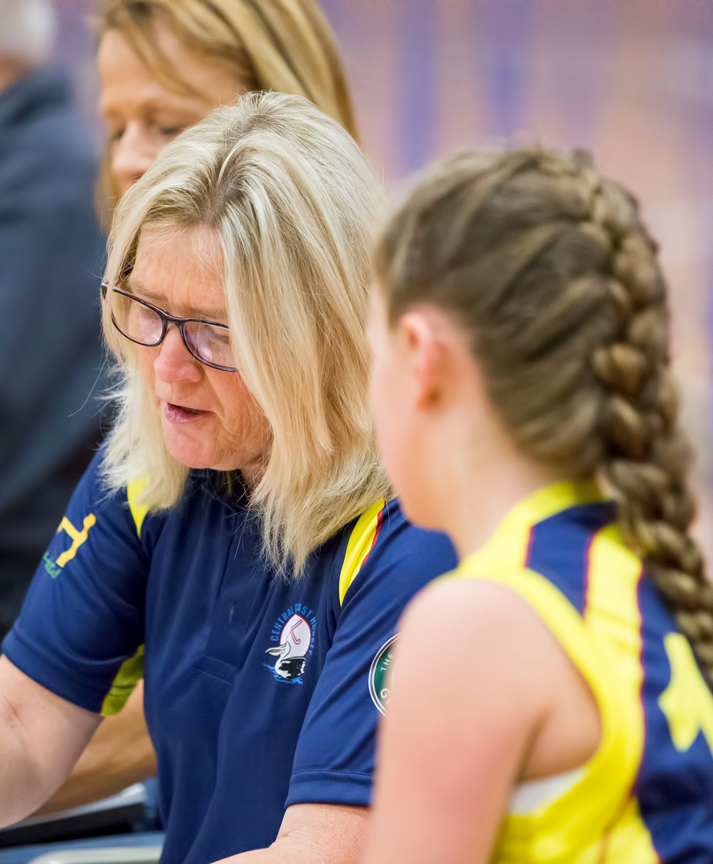
ASSESSORS
Suitably skilled, qualified and experienced adults. Examples:
  Teacher
  Coach
  Instructor
Help you set your SMART goals.
Give final sign-off on the activity.
Must meet Working with Children Check requirements.
Notes:
Cannot be a family member.
Does not need to be with the Duke of Ed for every hour that they log.
Mention Assessor Commencement Guide.

Slide 15
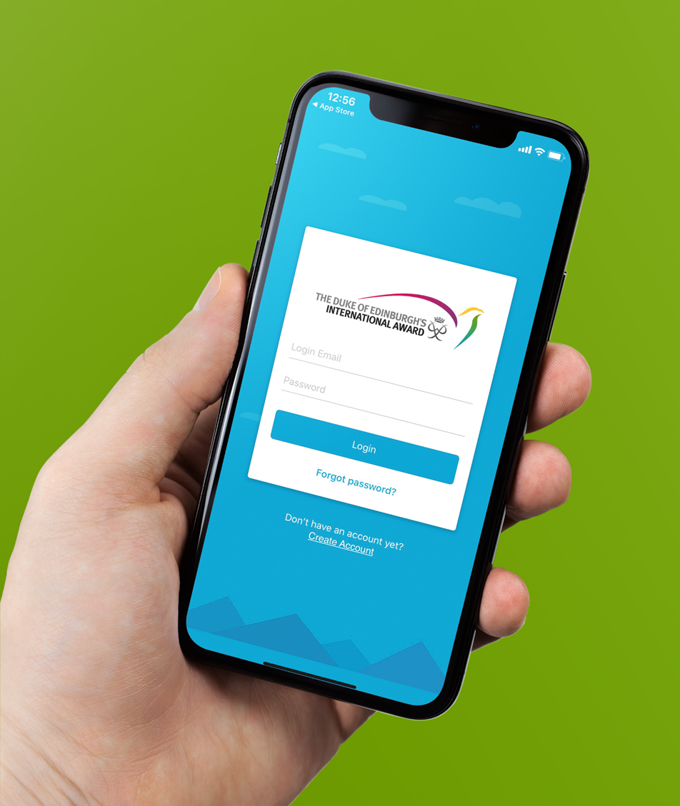
HOW TO GET STARTED
Speak to your Duke of Ed Leader.
Visit www.onlinerecordbook.org to register your interest for the Duke of Ed:
  Get your parent/guardian's approval
  Pay the registration fee
  Record all future Duke of Ed information in the ORB (web and app versions available)
Notes:
Mention any school specific registration processes.
Mention parent/guardian approval is required.
Mention all Assessors are pre-approved and require mandatory Child Safe checks

Slide 16


Duke of Ed Leader Contact Details
Name
Position
Email
Contact Number
Notes:
Add your details here

